Slide 1
Build Finance and Operations Apps
LP1
Learning Path 2

Slide 2
Learning Path Agenda
Set up a VHD
Start developing by using Visual Studio
Get started with development using X++
Develop object-oriented code
Implement application lifecycle management
Build extended data types and enumerations
Build data model
Build forms and optimize form performance
Create classes
Build reports
Build workspaces
Implement role-based security
Apply basic performance optimization

Slide 3
Module 1: Set Up a VHD
LP1
Learning Path 2
Module 1
Notes:
Module link: https://learn.microsoft.com/training/modules/set-up-vhd-finance-operations/

Slide 4
Introduction
In this module, you’ll learn:
1
A VHD is a useful tool to know how to create and update.
2
The VHD environment may be hosted on your own computer, with a server that’s hosted in Microsoft Azure, or any other on-premises architecture.
3
You can download the VHD files from Lifecycle Services.
Notes:
Note: With a downloadable virtual hard disk (VHD) for finance and operations apps, you can:
Download it to develop on, ensuring that no issues will occur with other pieces of architecture or your implementation.
Use it for extra testing.

Slide 5
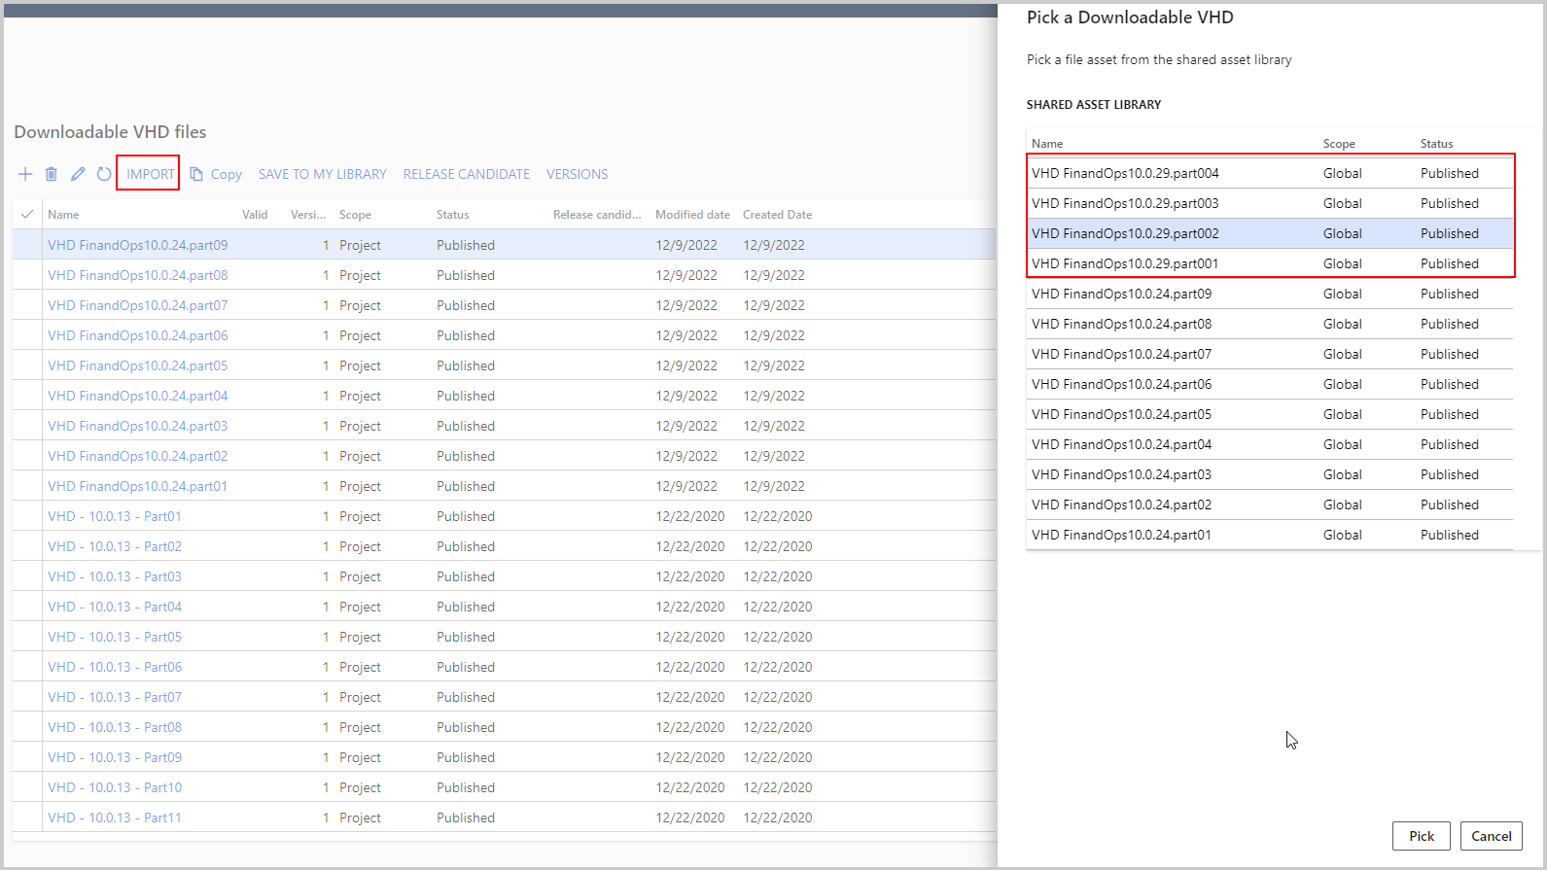
Set Up a VHD for First-time Use
Some steps to set up VHD for first-time use:
Locate the VHD files in the Asset library of Lifecycle Services.
Access the Downloadable VHD files page and select the IMPORT button.
Add all parts of the VHD by selecting the Pick button in the sidebar for each part of the VHD.
Download the parts of the VHD by selecting the highlighted text for each part of the VHD.
The picture on the right is a screenshot highlighting how to import and pick a downloadable virtual hard disk.

Slide 6

Set Up and Manage a Downloadable VHD for Development
How to set up and manage a downloadable VHD for development:
Double-click part01 to extract compressed files and create a single .vhd file.
Enable Hyper-V in Windows by searching “Turn Windows features on or off” and checking Hyper-V folder.
Set up a new Hyper-V virtual machine by selecting New > Virtual Machine in Hyper-V Manager and configuring memory and networking.
Install Visual Studio, SQL Management Studio, and other necessary applications on the VM.

Slide 7
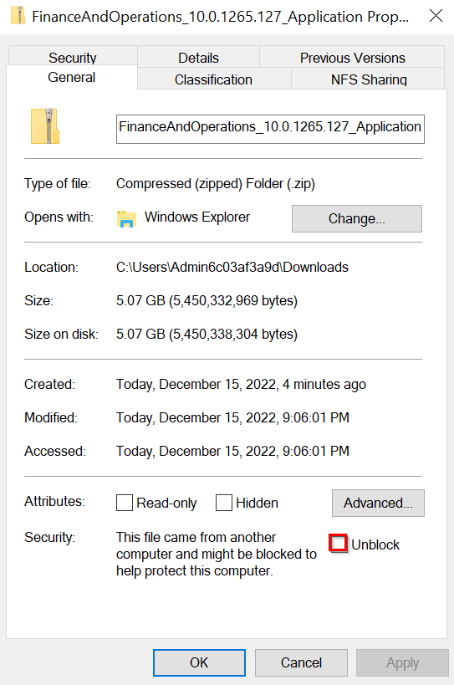
Upgrade the VHD
Some steps to Upgrade the VHD:
Download the newest version of the update from Lifecycle Services Asset library onto the VHD and unlock the .zip file. The picture on the right is a screenshot showing the Properties windows of a .zip file that contains a checkbox.
Extract the contents of the .zip file to a location on the VHD’s local drive, such as C:/Temp.
Open Command Prompt tool as an administrator and navigate to the same folder.
Run the command “AXUpdateInstaller.exe devinstall”.
Wait for the process to complete, and then do a compile and sync through Visual Studio to ensure that the VHD is operational after the update.

Slide 8
Exercise – Install a Virtual Machine
Exercise 1: Install a virtual machine
Install a virtual machine:
In this exercise scenario, you’re a developer at a company and need to download the virtual hard disk (VHD).
Notes:
All exercises are optional.
Link is https://learn.microsoft.com/training/modules/set-up-vhd-finance-operations/exercise-install-virtual-machine

Slide 9
Knowledge Check
1
Where is the downloadable VHD located in Lifecycle Services?
2
What installation process is like updating the VHD’s finance and operations apps version?
3
How do you restore a copy of your Production environment database over the local database on the VHD?
Notes:
1. In the Asset library: The VHD and the files that you need are in the Asset library under the Downloadable VHD node.
2. Installing a deployable package on a cloud-hosted development environment: The process to update the VHD’s finance and operations apps version is similar to that of a deployable package on a cloud-hosted development environment.
3. You’ll follow the directions for database operations that are provided by Microsoft to first restore the database from Production to a Tier 2/UAT environment through Lifecycle Services and then export it: The correct process is to follow the directions from Microsoft to first restore it over a Tier2/UAT environment and then export it.

Slide 10
Summary
In this module, you’ve learned:
How to download and update a virtual hard disk (VHD) for finance and operations apps.
How to set up SQL Server Management Studio, Visual Studio, and more to use the VHD.

Slide 11
Module 2: Start Developing
LP1
Learning Path 2
M1
Module 2
Notes:
Module link: https://learn.microsoft.com/training/modules/customize-visual-studio-finance-operations/

Slide 12
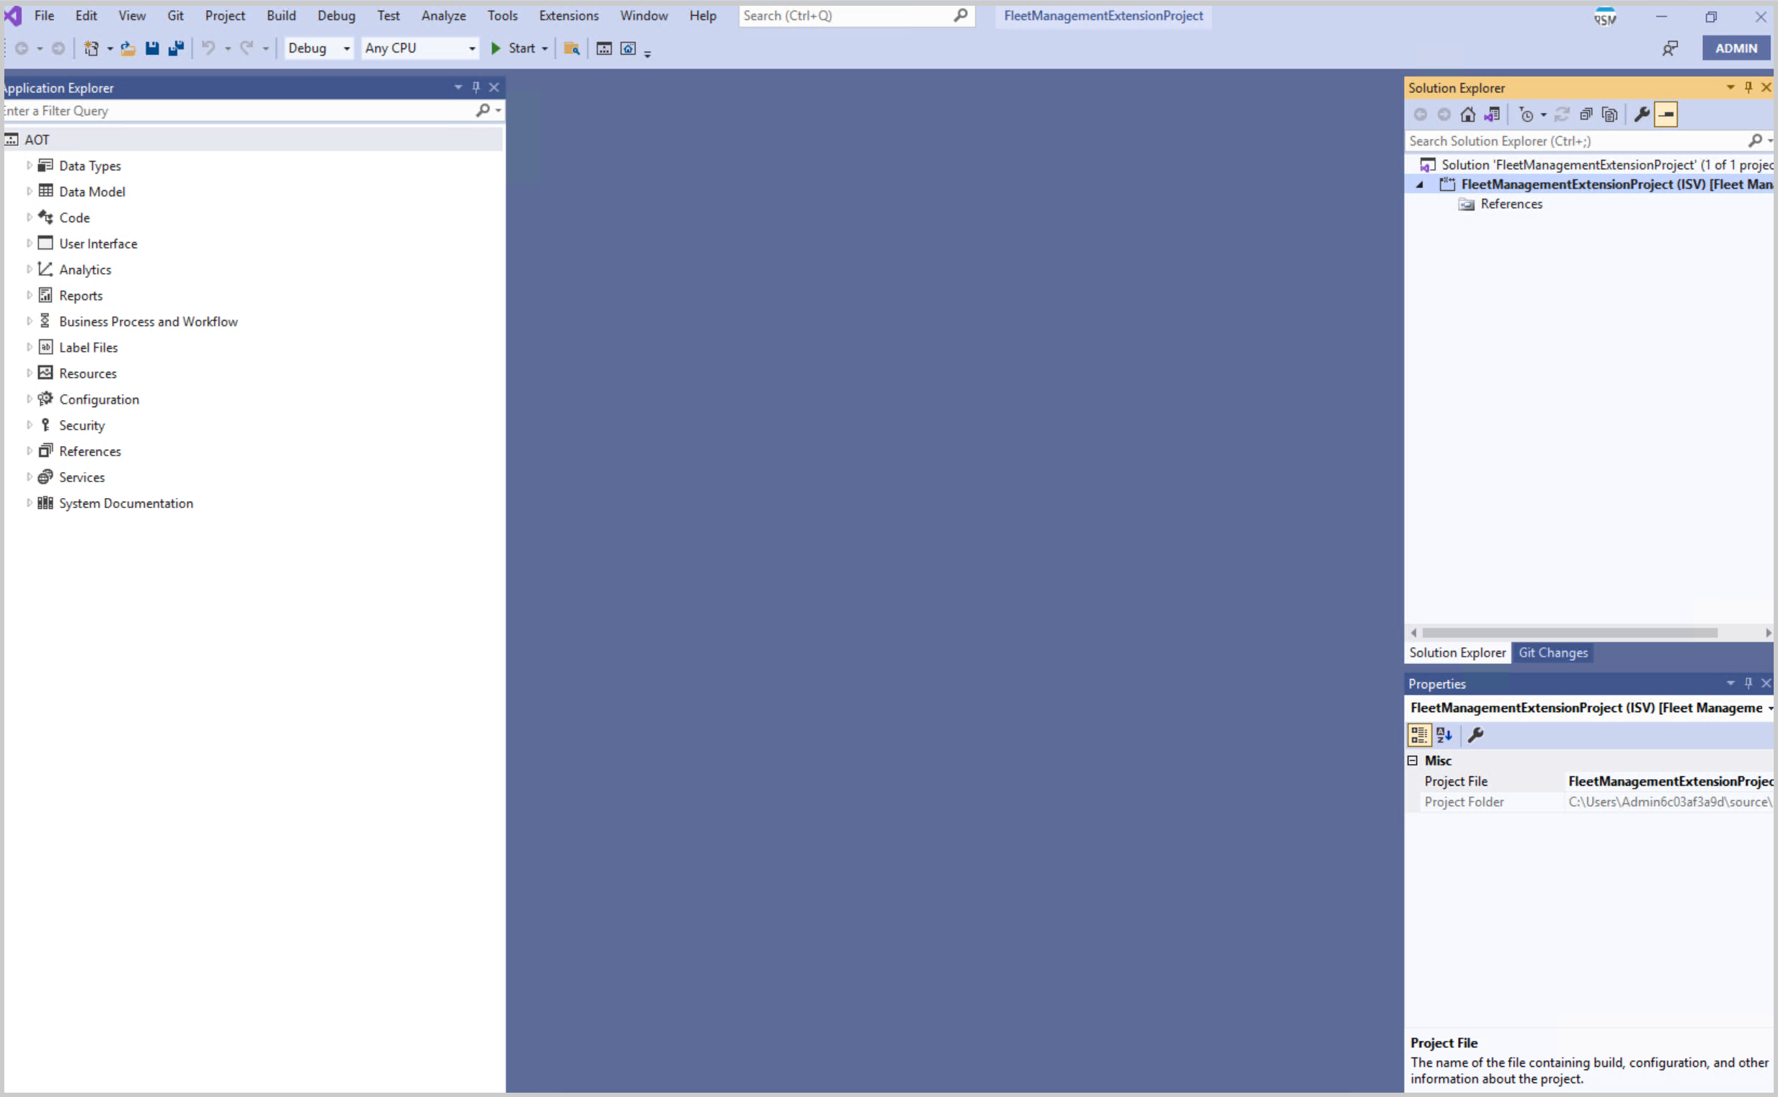
Introduction
In this module, you’ll learn:
Developers use Visual Studio to create and customize elements and perform other developer operations.
The Element Designer is used to create elements, while the Application Explorer is used to manage elements.
It is important to synchronize any data changes with the database to Ensure that all elements are up to date in the Application Object Tree (AOT).
Screenshot of the Visual Studio user interface.

Slide 13
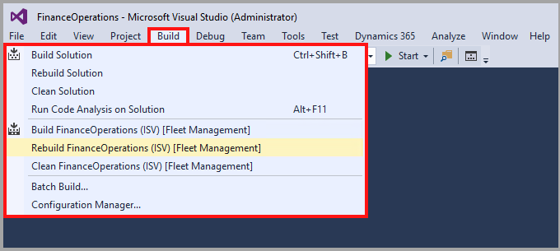
Create and Build Projects
Projects in Visual Studio contain elements, which are stored as metadata when they are built. The metadata is then used by the application to run your extensions.
To create a new project, go to File, then New, and then select Project or hold Ctrl + Shift while pressing the N key.
To build models, select Build Models from Dynamics 365 menu and select which models to build.
Screenshot of the Visual Studio Build menu:

Slide 14
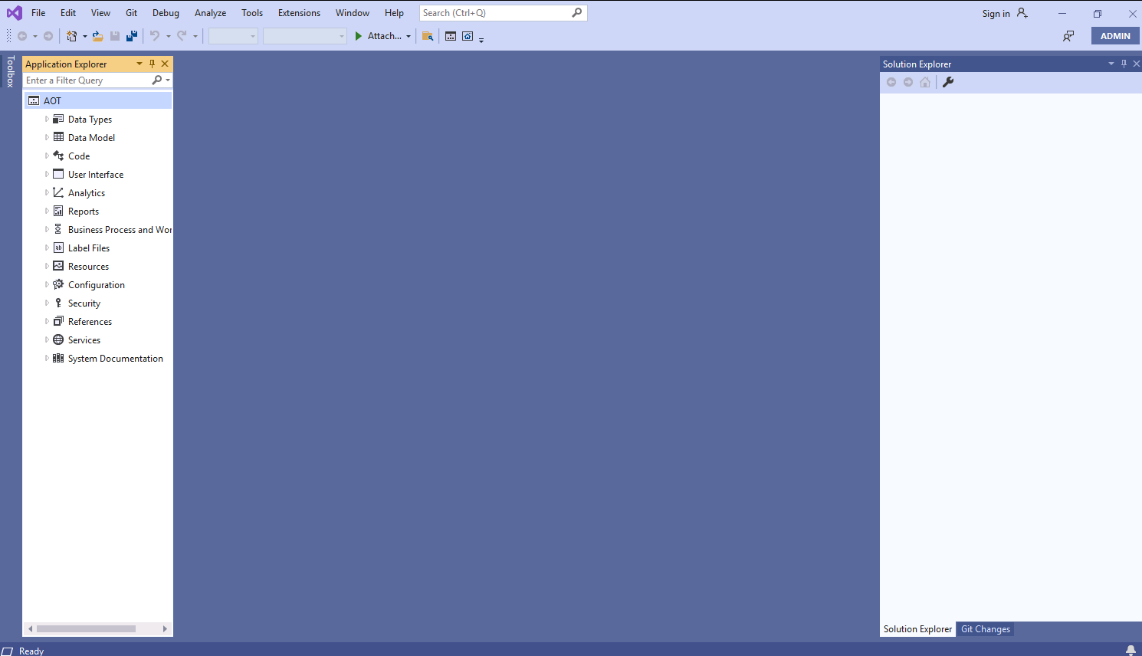
Demo – Create and Build Projects
DEMO
Notes:
https://www.microsoft.com/videoplayer/embed/RE4bbcG?postJsllMsg=true
This video demonstrates how to create a new project.

Slide 15
Create and use labels
Label files can store text localization for a user interface (UI).
One label field created per language.
Used by referring to the following parts (@MyLabelFile:CustName):
Red part – label file Id: Id for the label file.
Blue part – Label Id: An ID in text describing the label output.
Used on properties and in code.
Can’t be extended, but it’s possible to create a labelfile with postfix _Extension, such as Sys_Extension.
The following code example depicts an information to a user throw code. The returned label will be in user language.
X++
public static void main(Args _args) { Info(strFmt('@MyLabelFile:CustName')); }

Slide 16
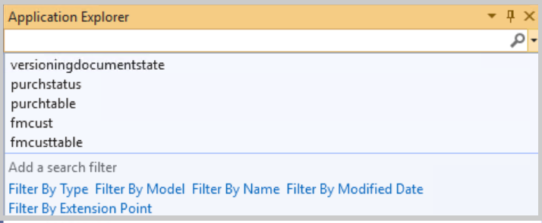
Manage Metadata by Using the Application Explorer
The Application Explorer contains the Application Object Tree (AOT), which has two views:
Model view: Model view organizes metadata by the model that contains it
Classic view: Classic view groups metadata elements by their type
Metadata types
Extended Data Types (EDTs)
Enums
Tables
Forms
Data entities
To view the types of filters you can use in the AOT, select the Search field and begin typing in the Application explorer. The picture on the right is a screenshot of the Application Object Tree filter.

Slide 17
Build Deployment Packages
To build an SDP (Software Deployable Package) from Visual Studio, follow these steps:
Go to Builds in Team Explorer.
Right-click the desired build definition.
Select Queue New Build.
In the browser window that opens, sign into Azure DevOps.
Use the Queue button to open the build queue dialog box.
Enter any parameters that you need to in the dialog box.
Select Confirm to queue the build.
When the build completes, the logs and the built code are available to download.
You can use Visual Studio to monitor and track your Azure DevOps builds.

Slide 18
Demo – Build Deployment Packages
DEMO
Notes:
https://www.microsoft.com/videoplayer/embed/RE4byCh?postJsllMsg=true
Watch this video to learn about creating a deployable package.

Slide 19
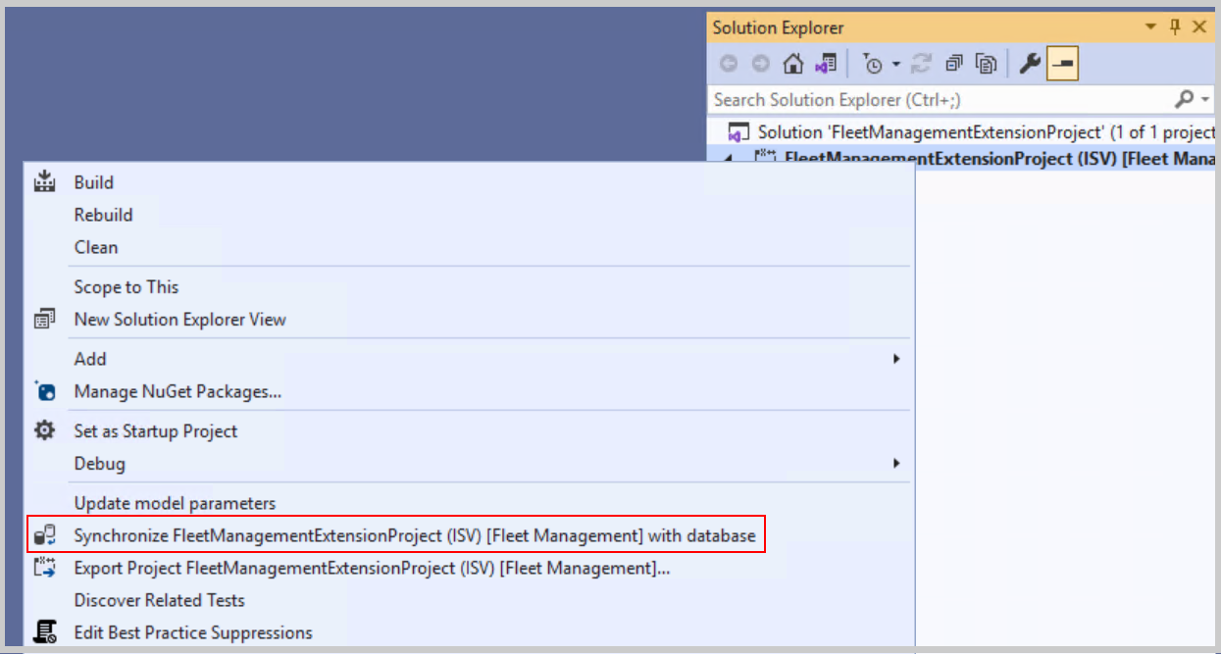
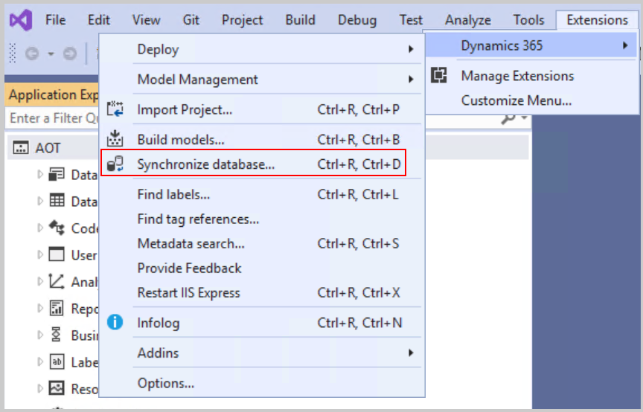
Synchronize Data Changes with the Database
How to synchronize the database:
Select Synchronize Database from the Dynamics 365 menu and then use the Synchronize button in the dialog box.
You can also select Synchronize Database on Build on the Options tab of the Build Models dialog box
Sometimes, an out-of-sync database will cause finance and operations apps to throw SQL errors.
The right screenshots show the different options for synchronizing both your project and the overall code base with the database.

Slide 20
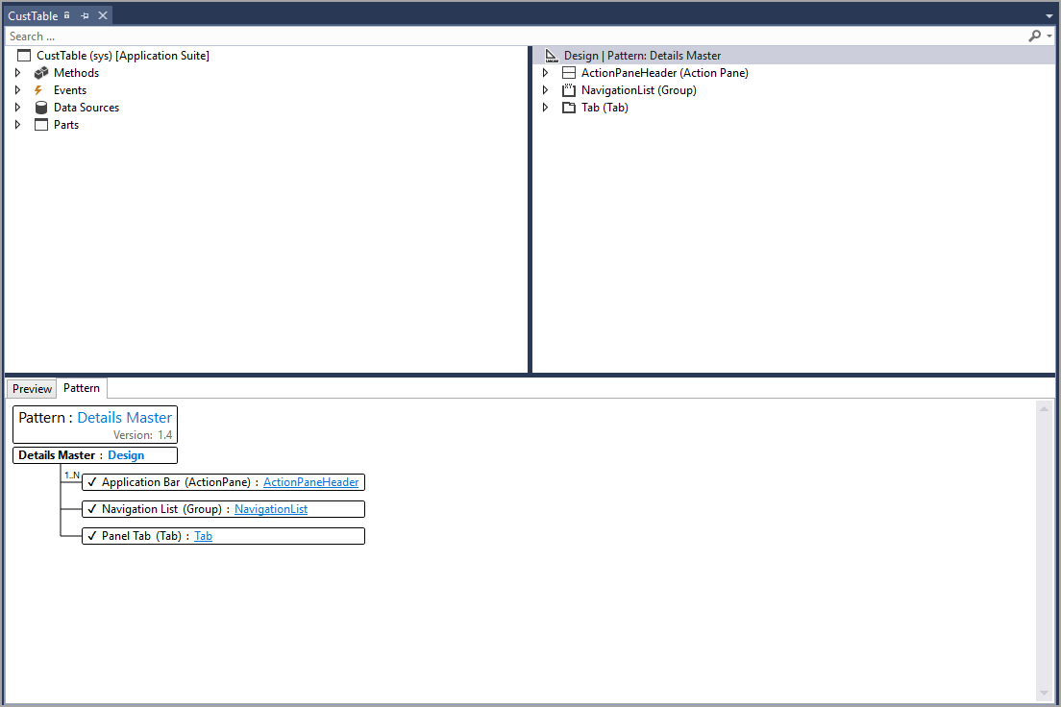
Use the Element Designer to Create Elements
The Element Designer is the center of development in Visual Studio.
Creating a new element starts in the Solution Explorer window:
To create a new element, right-click the project, select Add new item, choose what kind of object to add, and give it a name.
Select the element in the Solution Explorer window.
To extend an element from the AOT, right-click it, and select Extend.
Forms have their own layout, which consists of three windows:
Form Designer
Normal Element Designer
Pattern Designer
The image on the right is an example of the Form element designer.

Slide 21
Exercise – Create a Project and Add an Element
Task 1: Read this first – Before you start the lab!
Task 2: Scenario
Task 3: Create a new project
Task 4: Create a new vehicle color EDT
Task 5: Close the lab environment
Scenario
The finance and operations apps developer is a new employee at the Fleet Management company. The developer needs to create their own project in Visual Studio to begin developing new elements. The developer has been tasked with creating a new Extended Data Type (EDT) for vehicle color.
Notes:
All exercises are optional.
Link is https://learn.microsoft.com/training/modules/customize-visual-studio-finance-operations/7-exercise
Lab - Create a project and add an element - Training | Microsoft Learn

Slide 22
Knowledge Check
1
You need to change how the VendorInvoiceLineEntity functions. Which actions should you take to start?
2
When does your code become available locally in finance and operations apps?
3
You have extended a table to add fields in Visual studio, you have performed a build, but you are not seeing the new fields you have added to the table. Which actions should you perform to ensure your table extension updates, and displays on the table?
Notes:
1. Extend VendorInvoiceLineEntity: Most elements can be modified by extension.
2. When you build it: Building is what creates the metadata to reflect your code, and the metadata is what finance and operations apps uses to define its behaviors.
3. Database synchronization: If your table isn't syncing, you should perform a database synchronization.

Slide 23
Summary
In this module, you learned how to perform the following tasks in Visual Studio:
Create and build projects
Manage metadata by using the Application Explorer
Build deployment packages
Synchronize data changes with the database
Use the Element Designer to create elements

Slide 24
Module 3: Get Started with Development Using X++
LP1
Learning Path 2
M1
M2
Module 3
Notes:
Module link: https://learn.microsoft.com/training/modules/get-started-xpp-finance-operations/

Slide 25
Introduction
In this module, you’ll learn:
1
X++ has a user-friendly memory management model that is identical to .NET.
2
A few areas where X++ differs from other managed languages are:
Strong data access statements
Tight integration with system and user metadata
A strong extensibility story with Pre/Post event handlers and chain of command
Case insensitivity, meaning that “While,” “while,” and “WHILE” are the same (C# is case-sensitive)
3
X++ includes existing application classes for programming different business processes that can be easily extended for customizations.
4
X++ shares many keywords from SQL.
Notes:
Note: To start programming, you will need access to a finance and operations apps developer environment and Visual Studio, you will also need a Visual Studio license.

Slide 26
Implement Base Types and Operators
This unit explains the different data types and operators that are used in X++.
Data types: X++ has primitive data types like boolean, int, and str, as well as composite data types like arrays, containers, and tables.
Variables: Variables are identifiers that designate a storage location where a value of a data type is stored.
Operators: Operators are used to compute values. The different types of operators include assignment operators, arithmetic operators, and relational operators.

Slide 27
Demo – How to Declare a Variable
DEMO
Notes:
https://www.microsoft.com/videoplayer/embed/RE4bJ1i?postJsllMsg=true
This video demonstrates how to declare a variable.

Slide 28
Common Structured Programming Constructs of X++
X++ uses classes to define data and create objects.
The class declaration holds the name of the class, the instance variables, and other modifiers.
You can determine the visibility of the variables by using three modifiers: private, protected, and public.
Classes, unless they are static classes, need to be instantiated before they can be used.
Methods can be instance or static methods, with a signature and a body.
The following is an example of a class declaration plus declaration of a member variable:
X++
public class CustomerDetails
{
private str custName;
}
The following is an example of a method. The method is a public method that returns a real data type.
X++
public real ReturnCalculation(real _expression1)
{
real expression2 = 2;
return _expression1 * expression2;
}

Slide 29
Use X++ to Write SQL Statements
You can use SQL statements in X++ to manipulate data.
Select statements are used to choose what data will be retrieved from the database.
The Field list specifies which data to retrieve.
After the Field list, the keyword "from" is used, followed by the table to pull from.
Update methods can change existing values on a table record, on the right is an example of using an update method and the update_recordset statement.
Delete methods can remove an existing record from a table, on the right is an example of using a delete method and the delete_from statement.
X++
ttsbegin;
Select forupdate salesLine where salesline.salesId == 'S0001’;
salesLine.unitPrice = 10;
salesLine.update();
ttsCommit;
update_recordset salesLine
setting unitPrice = 10
where salesId =='S0001';
X++
ttsbegin;
Select forupdate
salesLine where salesline.salesId == 'S0001’;
salesLine.delete();
ttsCommit;
delete_from salesLine
where salesLine.salesId == 'S0001';

Slide 30
Use Conditional and Iterative Statements
Conditional statements (if, if...else, switch, ternary operators) are used to determine if a block of code should be run.
Iterative statements (while, do...while, for) repeat a statement block until a condition has been satisfied.
Different conditional and iterative statements have different advantages and uses depending on the situation.
Break statements: Terminating loops and Separation of case statements in a switch statement.
When used within a while, do...while, or for loop, the loop is terminated and implementation continues from the statement that follows the loop, as shown in the following example.
X++
mainMenu = SysDictMenu::newMainMenu();
enum = mainMenu.getEnumerator();
found = false;
while (enum.moveNext())
{
menuItem = enum.current();
if (menuItem.label() == parentDictsecuritykey.label())
{
found = true;
break;
}
}
if (found) //Belongs in Navigation Pane.
{
...
}

Slide 31
Demo – Conditional Statements
DEMO
Notes:
https://www.microsoft.com/videoplayer/embed/RE4byCj?postJsllMsg=true
Watch this video to learn about conditional statements:

Slide 32
Exception Handling
User messages
Exceptions inside transactions
Message() API can be used to control the lifecycle of a message and add/remove messages.
Message::AddAction() method supports adding an action associated with a display or action menu item.
If an exception is thrown inside a transaction, the transaction is automatically aborted.
Notes:
Note: exception handling is used to deal with errors.
throw statement can be used to give an error exception.
try...catch statement can be used to process code and handle exceptions.
retry can be written in a catch block to jump back to the first line of code within the try block.
finally clause can be added to a try...catch statement to execute statements when the try block exits.

Slide 33
Use Const Values
Constant values can be used to define a variable and assign it a value that does not change.
You can define a constant variable by adding the keyword const before defining a variable.
The following example shows how to make a variable a constant variable.
X++
const str constantVariable = "Value";

Slide 34
Use X++ Runtime Functions for Common Tasks
X++ provides several system functions that can be run with code.
Business operations
Container operations
Conversions
Date operations
Mathematical operations
Reflection operations
Session operations
String operations

Slide 35
Call .NET Libraries by Using X++ Code
You can create a reference from a finance and operations apps project to a C# class library, or to any type of C# project that generates an assembly, by following
these steps:
Build the C# project first.
Add the C# project and a Unified Operations project to your solution.
You can add a reference to a C# project or other .NET assemblies within Solution Explorer. Right-click the References folder and select Add Reference.
A reference element is added to your project, and a .dll file is copied to the bin folder of your package.

Slide 36
Knowledge Check
1
You need to create and assign a data type to a variable. The variable should only have access to a defined list of values “Invent,” “Sale,” and “Purchase.” Which data type should you use?
2
You need a conditional statement that checks if a variable equals “In progress,” “Completed,” or “Canceled.” Different code needs to run, depending on what the variable equals. A default block of code needs to run if the variable does not equal any of the values. What conditional statement is most appropriate?
3
An error is sometimes thrown in a certain try…catch block. You know that the issue can be fixed within the code during the error handling code block. What statement could you use when the error is found to run the code again?
Notes:
1. The enum data type should be used: The enum type allows you to use a defined list of values.
2. Switch statement: The switch statement allows you to use cases. If the case matches the value of the switch expression, then a specific code block can run. A default case can also be used when no other cases match.
3. The retry statement could be used in the catch statement to rerun the try block: The retry statement will rerun the try block to give the code another opportunity to succeed.

Slide 37
Summary
Several pieces of X++ code come together to perform tasks:
Variables can be used with a data type to assign values to an object.
Operators and global functions compare, manipulate, and calculate the variable values.
Methods are written to perform specific tasks with those variables.
Conditional statements determine the flow of code within those methods.
Error handling deals with exceptions that might occur during the code runtime.

Slide 38
Module 4: Develop Object-oriented Code
LP1
Learning Path 2
M1
M2
M3
Module 4
Notes:
Module link: https://learn.microsoft.com/training/modules/develop-object-oriented-code-finance-operations/

Slide 39
Introduction
In this module, you’ll learn that:
1
Object-oriented programming (OOP) is a programming paradigm that is modeled around objects and how you manipulate them.
2
When developing with an object-oriented language, you will first need to define the objects to manipulate and how they relate to each other.
3
The basic concepts of object-oriented-programming.

Slide 40
Explore Inheritance and Abstract Classes
Inheritance
Abstract
Inheritance allows a subclass to extend a super class.
The subclass inherits all the attributes and methods of the super class.
Abstract classes are identified by the keyword abstract.
Abstract classes are used to implement a concept that the subclass will then complete.
Abstract methods can also be declared in abstract classes.

Slide 41
Use Attributes
Attributes represent or store metadata about the behaviors of classes and methods.
An attribute can be attached by simply typing the name of the attribute that is enclosed in square brackets before the declaration of class/function.
Attributes can also be created by using attribute classes.
Attributes have many uses, such as specifying characteristics to enforce security.

Slide 42
Implement Chain of Command
Functionality for class extensions in Dynamics 365 finance and operations apps development.
Customize standard classes without using event handlers.
Create a new class with _Extension suffix and ExtensionOf attribute to declare class.
Use next keyword to create CoC to add custom logic before and/or after standard code runs.
Certain methods cannot be wrapped by using CoC, such as private methods.
The following code example shows how the class must be declared to use CoC.
X++
[ExtensionOf(classStr(ExampleClass))]
final class ExampleClass_Extension
{
str doSomething(int arg)
{
// Custom logic before standard code.
var s = next doSomething(arg);
// Custom logic after standard code.
return s;
}
}

Slide 43
Implement X++ Scoping and Access Identifiers
Scope:
Access Identifiers:
Internal:
Instance Variables:
Local Variables:
X++ variables and methods are within a defined scope.
The scope can be set by the placement of declaration and the use of access identifiers.
Public: Can be called from anywhere.
Protected: Can be overridden in subclasses.
Private: Can be called only from methods in the class.
It can only be accessed from within the model where it’s defined when you select a class or method as internal.
Have a large scope, can be accessed from any method in the class and subclasses if they’re declared public or protected.
Have a small scope, can only be accessed in the method where they're defined.

Slide 44
Interfaces
An interface is a set of public instance methods.
To create an interface, right-click the project in Solution Explorer, select Add, choose Interface, and enter a name for the interface.
A class that implements an interface must explicitly declare all the methods specified by the interface as public.
An interface can extend another interface by using the extends keyword.

Slide 45
Exercise – Create an Extension by Using Chain of Command
Exercise 1: Create an extension by using Chain of Command
Task 1: Before you begin:
Task 2: Create a new project:
Task 3: Create an extension of a method in the CustTable class
Notes:
All exercises are optional.
Link is https://learn.microsoft.com/training/modules/develop-object-oriented-code-finance-operations/7-exercise

Slide 46
Knowledge Check
1
What methods can you extend to use Chain of Command?
Methods declared with the keyword final
Private methods
Protected and public methods
Methods tagged with the attribute hookable(false)
2
Which of the following statements is NOT true about variable declarations?
You can use var to declare local variables for declarations of for loop counters
You can declare a variable wherever statements can be provided.
You can declare a variable after the variable is used.
You can declare variables in smaller scopes, outside which the variables can’t be referenced.
Notes:
Protected and public methods can use Chain of Command.
You can declare a variable after the variable is used: This statement is NOT true. You cannot declare a variable after it is used in code.

Slide 47
Summary
In this module, you learned that:
You can use core concepts like abstract classes, inheritance, and Chain of Command (CoC) to create a parent-child relationship between classes for customizations.
Attributes can be used to define and store metadata about classes and method.

Slide 48
Module 5: Implement Application Lifecycle Management
LP1
Learning Path 2
M1
M2
M3
M4
Module 5
Notes:
Module link: https://learn.microsoft.com/training/modules/application-lifecycle-finance-operations/

Slide 49
Introduction
Application Lifecycle Management (ALM) is about the management of software and implementations. There are different methodologies, and most companies use a hybrid. You should understand the concepts and main methodologies.
In this module, you will:
1
Define ALM.
2
Learn about the different ALM methodologies.
3
Build models.
4
Create a project plan for building and testing solutions.
5
Identify upgrade scenarios and appropriate tools.
6
Create processes for release management, change management, and risk management.

Slide 50
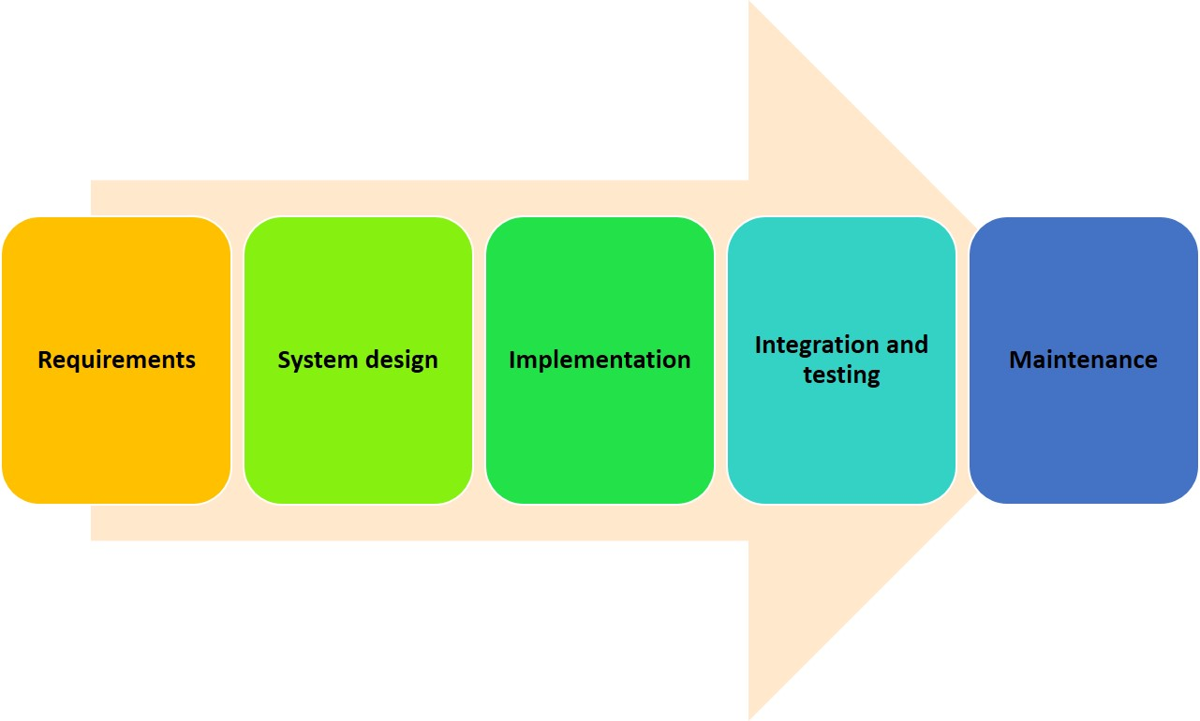
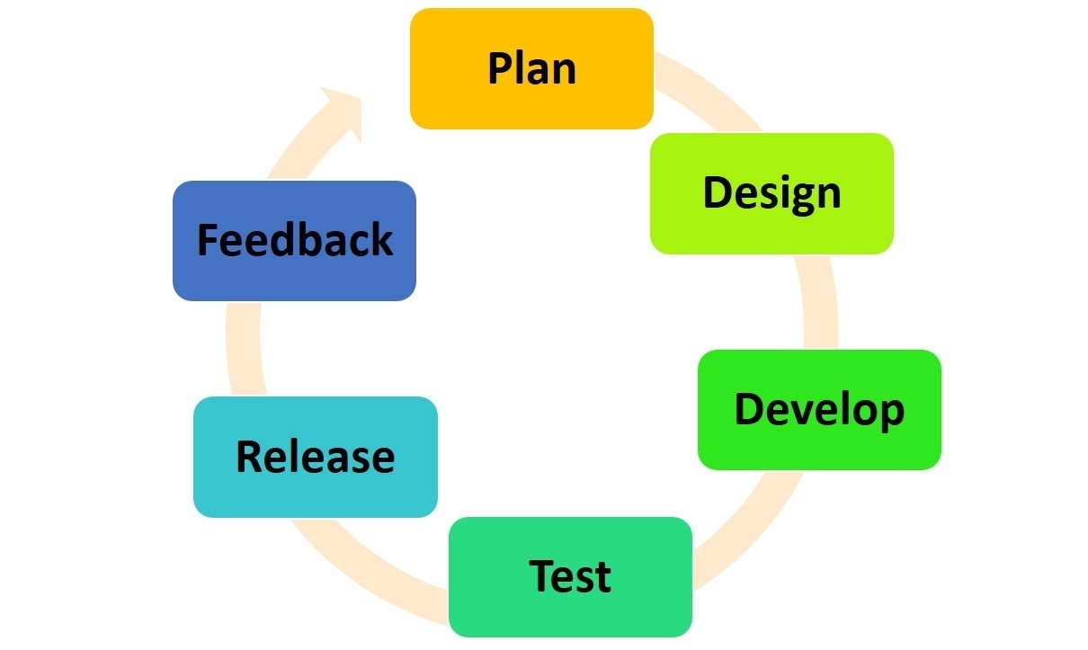
ALM Methodologies
Three common methodologies:
Agile methodology: Iterative approach, best for projects with unclear requirements or user-driven projects that need continuous feedback. The following figure is a cyclical diagram showing the six steps in the Agile methodology: Plan, design, develop, test, release, and feedback.
Spiral: Combines aspects of Waterfall and Agile, best for large-scale, complex systems that require proper risk assessment.
Waterfall methodology: Sequential approach, best for simple projects with well-defined requirements that won’t change. The following diagram shows the five stages of waterfall method: requirements, system design, implementation, integration and testing, and maintenance.

Slide 51
Design and Create Models
Importance of models
Create two types of models
Models are mandatory for customizations and help certain identify where objects are stored.
A model that is deployed in its own package.
A model that is part of an existing package.
Notes:
Note: A model is a group of elements, including metadata and source files that define a solution with customizations.

Slide 52
Plan the Build, Test, and Quality Control Processes
Create a project plan for builds
Decide what environments are needed
Plan for how much testing is required
Source control and quality control for developers
Select times and locations for builds
Decide the order of builds
Use Lifecycle Services to manage you build from environment to environment
Consider the environment’s purpose.
Consider the environment topology and tier.
Standard cloud offer includes a Tier-1, a Tier-2, and a production environment
Use unit tests, regression tests, and performance testing.
Use Task recorder tool to document the steps of a process that a user takes.
Use Azure DevOps to track updates, testing documents, and other notes.
Use Azure DevOps project for source control.
Version control lets you see what previous changes were made.
Follow the Microsoft Dynamics X++ best practices.
Notes:
Note: This unit reviews development processes that are used to manage the build, testing, and quality control processes, and provides information about how to plan for managing these processes.

Slide 53
Plan the Release, Change, and Risk Management Processes
This unit mainly introduces:
Identify risk:
Microsoft releases regular updates to finance and operations apps.
Releases are classified as upgrades and updates.
Before deploying any of the releases in your environment, consider reading the Dynamics 365 and Microsoft Power Platform Release Plans to discover what new updates are being added.
You will need to know which version that you want to select for upgrade.
You might run into compatibility issues if the release extends an enumeration.
Applying some risk management skills might help reduce these risks:
Identify any potential threats.
Assess what areas are vulnerable to those threats.
Determine the likelihood, or risk, of areas that are being affected.
Identify ways to reduce the risk.
Prioritize the risk reduction plans.

Slide 54
Knowledge Check
1
You are working on a project that has undefined requirements and new requirements are expected to occur during the project. What methodology would best suit this type of project?
2
A new developer is joining the project team. You, as the project manager, must request a new environment for the developer to use. What kind of environment should you request?
Notes:
1. Agile is useful when requirements are undefined and additional requirements are expected throughout the project life cycle.
2. Tier 1 environments are for development.

Slide 55
Summary
In this module, you learned:
Implementing the correct Application Lifecycle Management (ALM) methodology will prepare you for the development process.
Whether you choose the Waterfall, Agile, or Spiral methodology, your finance and operations apps implementation experience will be improved by using ALM.

Slide 56
Module 6: Build Extended Data Types and Enumerations
LP1
Learning Path 2
M1
M2
M3
M4
M5
Module 6
Notes:
Module link: https://learn.microsoft.com/training/modules/build-edt-enums-finance-operations/

Slide 57
Introduction
In this module, you’ll learn:
1
When to use base enums and EDTs and about the benefits of using each type.

Slide 58
Extended Data Types and Element Properties
The following primitive data types exist in the AOT and can be created in Visual Studio:
Benefits of using EDTs:
Booleans
Dates
Enums
GUIDs
Integers
Real
String
TimeofDay
UTCDateTime
Code is easier to read when you are using EDTs because the variables are named in a meaningful way.
The properties that you set for an EDT are used by all instances of that type, which reduces work and promotes consistency.
You can create hierarchies of EDTs, which inherit the properties that are appropriate from the parent and change the other properties.
Most fields in the tables of finance and operations apps are based on EDTs.
EDTs have various behaviors that you can use in your development.
Notes:
Note: X++ data types are divided into primitive data types and composite data types. In the AOT, you can create EDTs and base enums that build on the primitive data types.

Slide 59
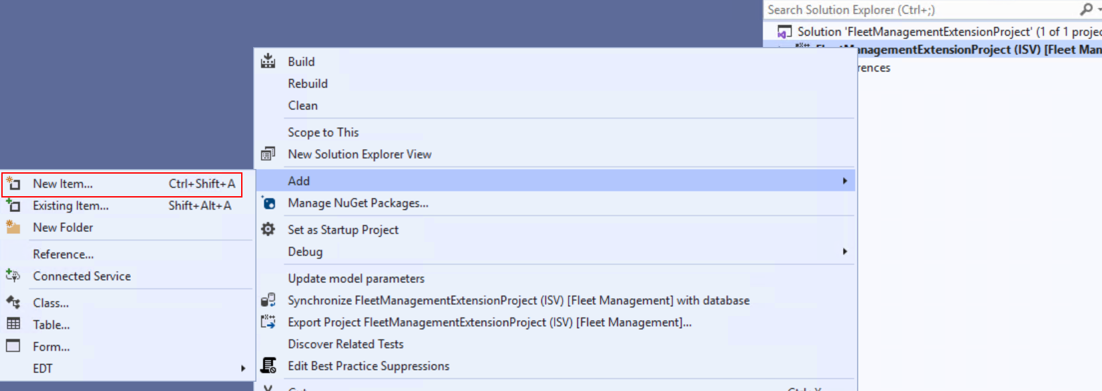
Base Enums and Element Properties
Base enums:
A base enum is a list of literals with an assigned value.
Enums can be used as integers in expressions when you are writing code.
The screenshot on the right shows how to add a base enum to your project in the Solution Explorer window.
Many enumerable types are built into the standard finance and operations apps.
Properties and elements:
Defining properties for a base enum allows you to modify the look of the base enum in the finance and operations apps user interface.
Elements that are added to a base enum are stored in the database as a numeric value.

Slide 60
Exercise – Create a Base Enumeration, Add Elements, and Update Properties
Scenario:
Task 1: Read this first – Before you start the lab!
Task 2: Scenario
Task 3: Create a new project:
Task 4: Create a base enumeration for vehicle type
Task 5: Add elements to the new base enumeration
Task 6: Close the lab environment
Notes:
All exercises are optional.
Link is https://learn.microsoft.com/training/modules/build-edt-enums-finance-operations/4-lab

Slide 61
Knowledge Check
1
How are base enums represented and stored in the database?
2
We recommend that you use EDTs whenever possible in coding for finance and operations apps. Which of these statements is not a benefit of using EDTs?
EDTs are more easily compiled.
EDTs are reusable throughout the system.
The code is easy to read.
Properties can be inherited from parent EDTs.
3
A base enumeration can be viewed in multiple ways in the user interface of finance and operations apps. Which of the following is not an example of how a base enum can be viewed in the user interface?
Option buttons
A slider bar
A date field
A drop-down menu
Notes:
A numerical value (or integer): Base enums are stored as numeric values (for example, 0, 1, 2) in the database.
EDTs are more easily compiled is not true: EDTs are compiled in the same way as any primitive data type.
A date field is an EDT, not a base enum, that is used in the user interface.

Slide 62
Summary
In this module, you have learned that:
Visual Studio contains many primitive data types, including base enums and EDTs.
Both EDTs and base enums can be pulled from the AOT in Visual Studio and added to a project, or you can create them through the Solution Explorer window.
After base enums and EDTs are created, they are usually added to a table to enable data capture.

Slide 63
Module 7: Build the Data Model
LP1
Learning Path 2
M1
M2
M3
M4
M5
M6
Module 7
Notes:
Module link: https://learn.microsoft.com/training/modules/build-tables-finance-operations/

Slide 64
Introduction
In this module, you will:
1
Define the use of tables in finance and operations apps.
2
Create a new table in Visual Studio.
3
Manage table properties.
4
Add fields and field groups to a table.
5
Create an index and a table relation.
6
Learn about table methods.
7
Create, manage, and extend views, queries, and maps.

Slide 65
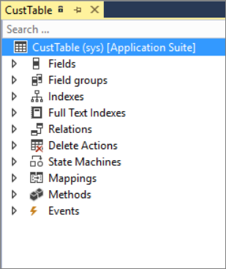
Create Tables and Table Fields
Tables contain rows and columns, just like a spreadsheet. They are stored in a database and work together to deliver data to the user in outputs such as forms and reports. Tables can also contain metadata.
Tables are made up of fields, which are organized into field groups.
The screenshot on the right shows the CustTable (Customer Table).
The Table designer window contains a top-level node with the table name, and various components beneath it, such as: Fields, Field groups, Indexes, Relations, Delete actions, State machines, Mappings, Methods, and Events.

Slide 66
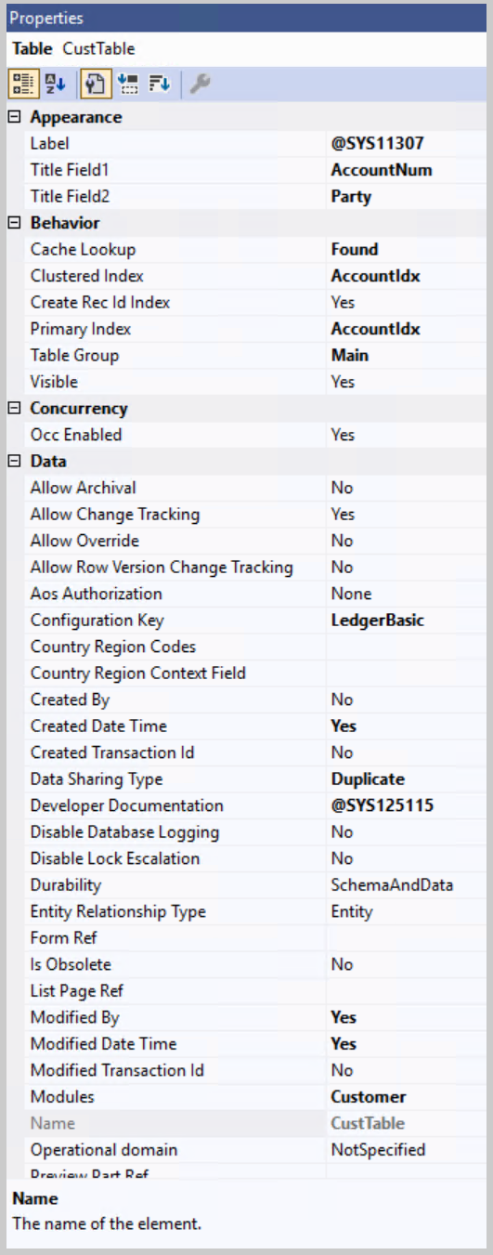
Populate Table and Field Properties
When adding a new element to a project, update and modify its properties
The picture on the right is a screenshot of the Properties page showing CustTable properties.
Key table properties: Type, Name, Label, Primary and Cluster index, Configuration key, Support inheritance, and Extends
Field properties are commonly adjusted at the element level
Base enum properties determine how the property is displayed in the user interface
EDT properties vary depending on the type of EDT

Slide 67
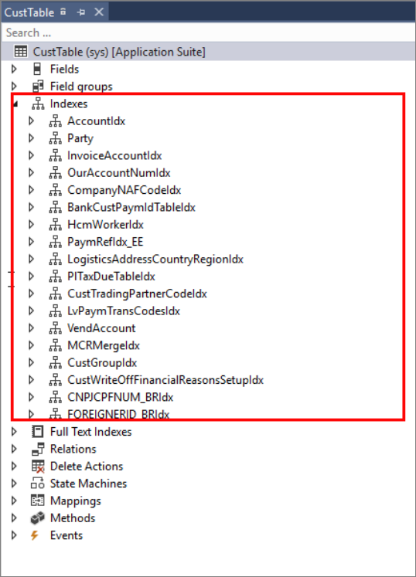
Add Fields, Field Groups, Indexes, and Relations
Field Groups improve consistency in form design and reduce the need for individual field selection.
Indices improve efficiency in data retrieval.
There are three types of indices: Primary, Clustered, and Non-clustered.
Table Relations are used to associate rows in one table to another, create auto-joins in forms, look up values in other tables, and validate data by providing constraints.
Relation types include Normal, Field Fixed, Related Field Fixed, and Foreign Key.
Screenshot of the CustTable highlighting the Table indexes.

Slide 68
Table Methods
Tables are main elements in finance and operations apps development and have standard/custom methods.
Standard table methods include initValue(), find(), insert(), modifiedField(), validateField(), and validateWrite().
You can use these methods to initialize, find, insert, modify, and validate data in a table.
Chain of command is an option that helps to enhance the functionality of a table method.
In the following example, the requirement is to initialize the Price Rounding rule of the Currency table with 0.01 whenever a new record is created. A table extension class will be created with this code snippet of the initValue() method.
X++
[ExtensionOf(tableStr(Currency))]
final class CurrencyTable_Extension
{
public void initValue()
{
this.RoundOffPrice = 0.01;
next initValue();
}
}

Slide 69
Create, manage, and extend views
Views are virtual tables based on tables or other views (view metadata) and contains rows and columns.
Columns or fields can refer to a field in the metadata or be a computed column.
Computed columns needs a method specified in ViewMethod property. The method for a computed column returns T-SQL as a string.
Views are created doing synchronization and will use the T-SQL from computed columns in creation.
View extensions can add functionality to the view, but not remove it.
View extensions can’t add computed columns since you can’t create methods in a view extension.
The following code example depicts the calculation of a computed column where only negative amounts are added. Computed columns are defined as a method returning T-SQL in a string.
X++
public static str negativeAmountMST()
{
#define.ViewName(AssetTransReverse)
#definere.Dataa SourceName("AssetTrans_1")
#define.AmountMSTField("AmountMST")
str amountMST;
DictView dictView;
dictView = new DictView(tableNum(#ViewName));
amountMST = dictView.computedColumnString(#DataSourceName, #AmountMSTField, FieldNameGenerationMode::FieldList, true);
return SysComputedColumn::negative(amountMST);
}

Slide 70
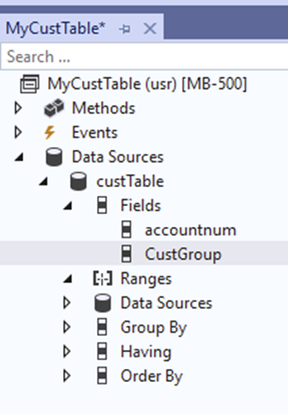
Create, manage, and extend queries
Queries are user-friendly, and you can use them to build SQL statements and render data into forms, reports, views, and more.
Queries can be predefined or built by code.
Use the following classes to build or modify queries:
Query, QueryRun, QueryBuildDataSource, QueryBuildRange
Predefined queries are extensible.
Change label
Add new data sources
Add new fields or aggregate function
New grouping, ordering, and having
You can’t remove existing data sources, fields, grouping, ordering, or having.
The following example depicts a predefined query.
Predefined query

Slide 71
Create, manage, and extend maps
Safely operate between record types (tables).
Functionality shared between tables.
Mapping defined on tables.
Not extensible itself.
Extensions can be applied by using the following steps:
Create a map.
Add mappings on the tables.
Add abstract class for map interface.
Add interface class for each table extended from the abstract class.
Add Interface class initiated on the map.
The following code example depicts the creation of an instance of an interface class.
X++
public static MyCustVendMapInterface createInstance(MyCustVendMap _myCustVendMap) { SysPluginMetadataCollection metadataCollection = new SysPluginMetadataCollection(); metadataCollection.SetManagedValue(classStr(MyCustVendMapInterface), tableId2Name(_myCustVendMap.tableId)); MyCustVendMapInterface instance = SysPluginFactory::Instance(identifierStr(Dynamics.AX.Application), classStr(MyCustVendMapInterface), metadataCollection); if (!instance) { throw error(strFmt("@SYS19306", funcName())); } instance.initializeMyCustVendMap(_myCustVendMap); return instance; }

Slide 72
Exercise – Create a Table, Add Fields, and Create Field Groups
Scenario: The finance and operations apps developer has been asked to create a new table for the Fleet Management company. The Fleet Management company needs to collect customer information in a different way than the out-of-the-box All Customers page. They want the table to contain both personal and location data by using existing elements in the AOT.
Task 1: Read this first – Before you start the lab!
Task 2: Before you begin and Scenario
Task 3: Create a new project and Create a table:
Task 4: Add fields to the table
Task 5: Create field groups and add fields to the field groups
Task 6: Close the lab environment
Notes:
All exercises are optional.
Link is https://learn.microsoft.com/training/modules/build-tables-finance-operations/4-exercise

Slide 73
Knowledge Check
1
A child table inherits properties from a parent table. Which two properties work together to control table inheritance?
2
Is it correct that if a modification is made to a field group, such as the addition of a new field, any forms that contain that field group will automatically update to reflect that addition.
3
An index is an important element that is added to a table. Which statement is true regarding indices? Which statement is true regarding indices?
The order of columns in an index is not important.
A primary index should have the “Allow Duplicates” property set to “Yes.”
A non-clustered index organizes data in a table according to the order of the index.
An index is used to improve the speed of data retrieval.
4
A computed column is added to a view. Which data type should be returned by the static view method for the computed column?
Notes:
The Extends and Supports Inheritance properties: The Supports Inheritance property can be selected as “Yes” or “No” to determine if a table supports inheritance. The Extends property is used to determine which table will be inherited from or extended.
Yes: Field groups store logical groupings of fields, such as different fields relating to an address. If fields are added to a field group, and that field group is used on a form, the form will automatically update to reflect the new fields that were added to the field group on the table.
An index is used to improve the speed of data retrieval: The main purpose of an index is to increase the speed of retrieving data.
A string with T-SQL: The view method for a computed column should return T-SQL to be executed on the SQL Server. In the DictView class, you can use the method computedColumnString to generate T-SQL. The SysComputedColumn class provides helpful syntax for more complicated computed columns.

Slide 74
Summary
In this module, you learned that:
Tables are used when developing forms in Visual Studio, and they appear to the user as pages in finance and operations apps.
Tables contain data such as transactional information, journal entries, products, and metadata such as system settings.
You can add EDTs and base enums to tables from your project in Solution Explorer or from the AOT to populate the Fields node in the Table designer.

Slide 75
Module 8: Build Forms and Optimize Form Performance
LP1
Learning Path 2
M1
M2
M3
M4
M5
M6
M7
Module 8
Notes:
Module link: https://learn.microsoft.com/training/modules/build-forms-optimize-finance-operations/

Slide 76
Objectives
In this module, you will:
1
Create a new form.
2
Apply a form pattern.
3
Add a data source to a form.
4
Add grids, fields, and groups to a form.
5
Understand form methods.
6
Discover the types of menu items.
7
Create a menu item and add it to a form.
8
Run a form and test its functionality.
9
Learn about browser-based and Performance Timer tools that are used to optimize form performance.

Slide 77
Introduction
1
Finance and operations apps use an HTML web client in major browsers
2
Forms are managed in Visual Studio and displayed as web pages
3
The user interface is optimized for multiple platforms and mobile apps
4
Business logic is available anytime, any place, and on any device.

Slide 78
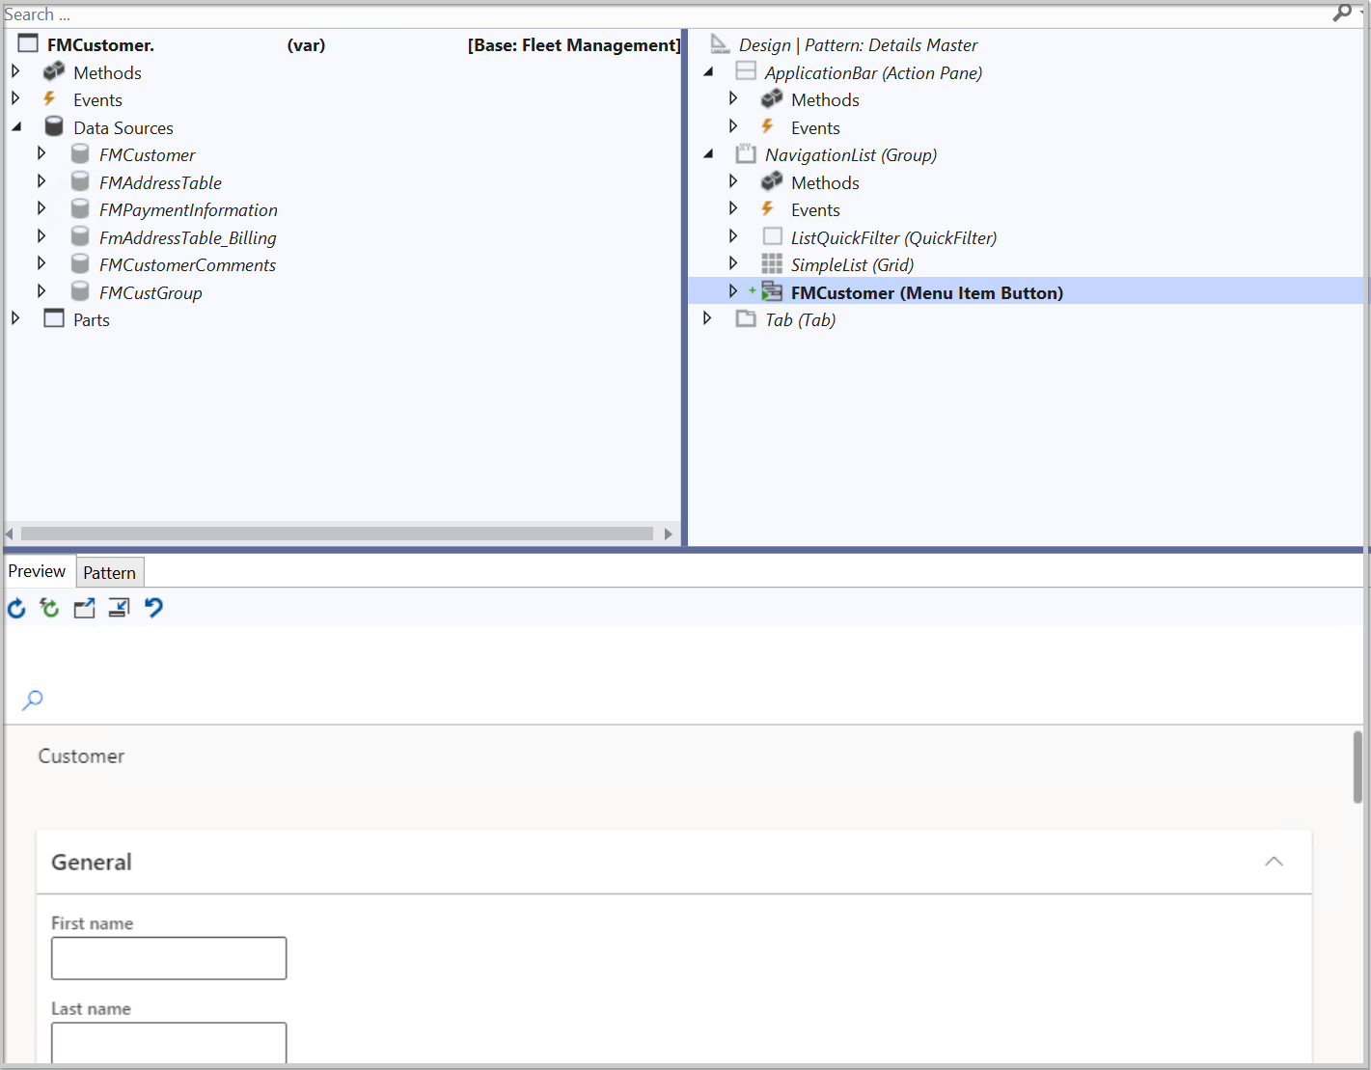
Add a New Form to a Project and Apply a Pattern
In Visual Studio, a form is added to a project in the Solution Explorer window
The left and right panes in the Visual Studio Form designer window manage form and design options, while the bottom pane shows pattern design and form preview.
The form’s left pane manages methods, events, and data sources, while the right pane applies patterns and subpatterns.
The bottom pattern pane is like a wizard because it guides you through the necessary steps to complete the pattern.
Notes:
Many of the form styles and templates from Microsoft Dynamics AX 2012 continue to be supported in finance and operations apps. If a legacy form style or template is no longer supported, there is likely a migration path to a current pattern.
Many form patterns are used in finance and operations apps. The following list highlights the most common patterns that you will encounter and develop. For a full list of supported form patterns and subpatterns, go to the Summary unit of this module.
Simple List pattern - Used to maintain data for entities that contain six or fewer fields and no parent/child relationships.
Simple List and Details pattern - Used to maintain data for entities that contain six or more fields.
Simple Details pattern - Used to present a simple set of fields to the user; generally, it is in view mode instead of in edit mode.
Master Details pattern - Used as a primary method for entering data. Users can view and edit data that is organized into expandable and collapsible FastTabs.
Details Transaction pattern - Used to present data details in a Header view and a Line view.
List Page pattern - Used to present data in a manner that is optimized for browsing records and allows the user to take action on a specific record.
Table of Contents pattern - Used when at least two forms are required for setup configuration.
Workspace pattern - Used to create a finance and operations apps workspace, which is a grouping of tasks and specific pages that are used for significant business activity.
Wizard pattern - Used to guide a user through a specific task by using an ordered series of tab pages.

Slide 79
Demonstration: How to Add a Form to a Project and Apply a Pattern to the Form
DEMO
This video shows how to add a form to a project and apply a pattern to the form
Notes:
https://www.microsoft.com/videoplayer/embed/RE4bJ1j?postJsllMsg=true

Slide 80
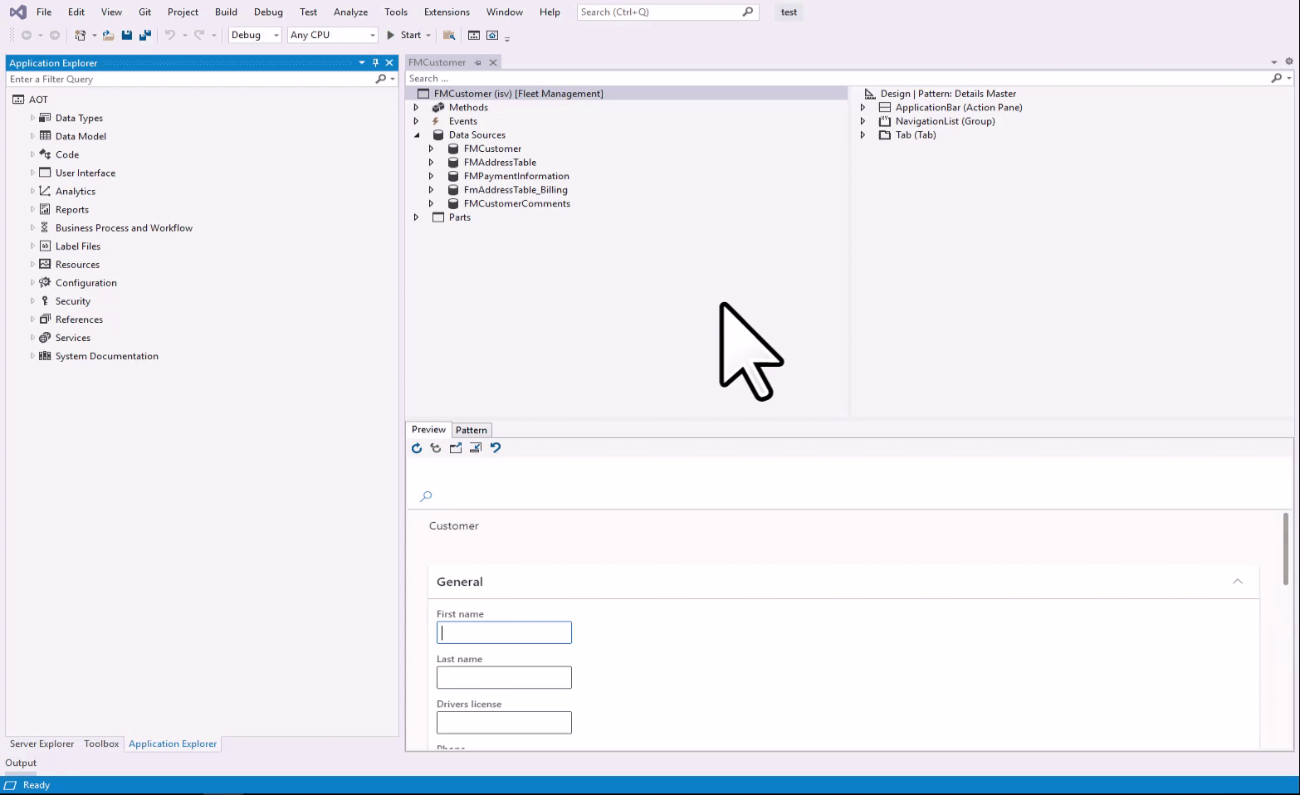
Add a Data Source to a Form
Follow these steps to add a data source from the Application Object Tree (AOT) to your form by using a select and drag process:
Ensure that your form is open in the form designer window in Visual Studio.
In the Application Explorer window, expand the AOT node. You can view the Application Explorer window by going to View > Application Explorer.
Expand the Data Model node.
Expand the Tables or Table Extensions node, depending on the type of data source that you are adding.
Select and drag your desired table from the AOT node to the Data Sources node in the left pane of the form designer window.
Notes:
To display content on a page in the user interface, a data source must be added to a form in the form designer window of Visual Studio. You can select and drag a table or query from your project in the Solution Explorer window or drag a system table from the Application Explorer window. You can choose to use one table or many tables, depending on the number of fields that you will use for your form.
Alternatively, you can add a data source to your form by using the Data Sources node in the form designer.
Follow these steps to add a data source from your project:
Ensure that your form is open in the form designer window in Visual Studio.
In the left pane of the designer, right-click the Data Sources node and select New Data Source.
Select DataSource1 under the Data Sources node and go to the Properties window.
Select your table in the Table property drop-down menu. You can also select any table from the AOT node in this menu.

Slide 81
Add Grids, Fields, and Groups to a Form
Follow below steps to add more controls to your form:
In Visual Studio, ensure that you have applied your desired form pattern by right-clicking the Design node on the right pane and selecting Apply pattern.
After adding a data source by following the steps in the previous unit, you will now begin adding controls to the form by following the steps in the correct order on the Pattern tab on the bottom pane of the form designer window.
Right-click the Design node on the right pane of the form designer and select New > Action Pane.
Right-click the Design node and select New > Group. Notice that the Group control requires a pattern. Based on the form type, you will choose a desired subpattern.
Right-click the Design node and select New > Grid.
From the left pane, expand the Data Sources node and then expand your table.
Expand the Fields node of your table.
Select the fields that you want displayed in the grid on your form, in the order that you want them displayed in the form. You can select multiple fields by using the Ctrl key.
Drag the selected fields from the Fields node on the left pane to the Grid node on the right pane.
Notes:
When a table is listed under the Data Sources node on the left pane of the Form designer window, it can then be used to add fields to the Grid node of the pattern design. The pattern that you select will determine the presence and/or location of the grid. Individual fields can also be dragged from the Fields node under the individual table in the Data Sources node to the right pane in the Grid node under the Design node.
A grid contains columns and rows and will display to the user as a table in a finance and operations apps page. Groups are part of multiple form patterns and are added to the form as filters. You can add quick filters and customer filters by applying a subpattern to the Group control.

Slide 82
Form Methods
Standard form methods
Standard form data source methods
Standard form data source field methods
init()
close()
closeCancel()
closeOK()
run()
init()
active()
validateWrite()
validateDelete()
executeQuery()
initValue()
write()
delete()
modified()
validate()
lookup()
Notes:
Forms are main elements of finance and operations development. Many standard forms are already available in the application.
You can also create new forms. Each form consists of form methods, which can be classified as standard methods or custom methods. Standard methods must have a super() call to implement the parent method. Standard and custom methods are available with all standard and custom forms. You can extend the existing form methods and include code by using chain of command.
Above methods can also be extended.

Slide 83
Create and Populate Menu Items
Menu items provide a button for users to access pages, dialog boxes, reports, or tasks.
Different types of menu items in Visual Studio:
Display menu item: For presenting forms and dialogs
Output menu item: For printing results (e.g., reports)
Action menu item: For performing jobs (e.g., creating or updating transactions)
Menu items simplify navigation and eliminate the need for manual web address entry.
Navigation pane in finance and operations apps can be extended to add modules or pages.

Slide 84
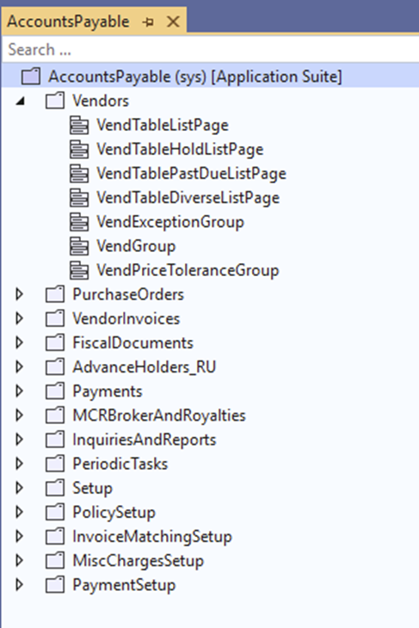
Create menus
Menus can be created to connect items to add new functionality in the Navigation pane.
There are different types of menus you can use in Visual Studio, including:
Menu Item Reference (display, output, or action).
Separator
Sub menu
Menu reference (a menu can consist of other menus)
Tile used for workspaces

Slide 85
Test Form Functionality and Data Connections
To test a form pattern before production, set it as the startup object in Visual Studio, build it, and preview it in a browser window in a virtual machine. This allows you to check the form’s functionality, components, and appearance based on desired patterns. Watch a video tutorial for more guidance.
Watch this video to see the process for setting a form as a startup object and previewing it in a web browser.
DEMO
Notes:
https://www.microsoft.com/videoplayer/embed/RE3ez1b?postJsllMsg=true

Slide 86
Diagnose and Optimize Client Performance
Diagnose and optimize client performance by using browser-based tools
Diagnose and optimize client performance by using Performance timer
Use browser-based tools like Fiddler, Chrome Developer tools, and Trace Parser to optimize form performance and diagnose potential issues
Fiddler is a free and customizable debugger tool that can diagnose authentication issues and enhance network performance
Google Chrome’s Developer tools allow you to record scenarios and analyze time spent loading, scripting, and rendering pages
Trace Parser is built into finance and operations apps and can be used to analyze performance issues by recording and analyzing traces
Performance Timer is a diagnostic tool for client and server performance issues
Access the Performance Timer by opening a web page with the added parameter debug=develop
The timer appears in the top-right corner of finance and operations, showing the separation between client and server time, as well as the total time for a selected page
Performance Timer provides links for viewing information about forms, garbage collection, web client sessions, and service session providers.

Slide 87
Optimize Form Loading and Performance
Users want fast loading pages and high performance in finance and operations apps.
Production environments move faster than development or sandbox environments.
Running forms in a browser window is important for form development.
Use info() statements in code to log status messages in the Infolog window.
Analyzing form data and removing unnecessary fields can improve performance.

Slide 88
Exercise – Create a Form
Scenario: The finance and operations apps developer has been asked to create a new form for the Fleet Management company. The company wants a simple page to enter customer information. They want the form to pull fields from the CustTable element.
Task 1: Create a new project
Task 2: Create a form
Task 3: Add a pattern and data source to the form
Task 4: Build the simple list form pattern
Task 5: Preview the form in a browser
Task 6: Close the lab environment
Notes:
All exercises are optional.
Link is https://learn.microsoft.com/training/modules/build-forms-optimize-finance-operations/9-exercise

Slide 89
Knowledge Check
1
When developing a new form for finance and operations apps, is it true that applying a form pattern is a mandatory step?
2
When all requirements for a form pattern have been satisfied, what must be done before you can build and preview the form in a browser window?
3
You want to attach a report to a menu item so the report will display when a user selects the menu item. Which type of menu item should be used to perform the task?
Notes:
No: Applying a form pattern is highly recommended and considered best practice when you are developing a new form, but it is not mandatory.
Set the form that you want to preview as the startup object for the project: You must first set the form you want to preview as the startup object for the project by right clicking the form in the Solution Explorer window and selecting that option.
Output menu item: An output menu item is used for showing and printing a result or report, such as an SSRS report.

Slide 90
Summary
After this module, you’ve learned:
Visual Studio forms consist of fields, tables, filters, and grids displayed to users as pages.
Best practice is to apply a form pattern to determine the layout, structure, and contents.
Developers can use tools such as Solution Explorer, form designer window, and browser-based tools to test and improve a form’s performance.
Analyzing load and refresh times can ensure a seamless user experience.
Labels are used to store text localization for a user interface (UI).
Navigation pane can be customized with menus.
Links to related modules (and sites) for specific topics
Topic | Link
Form guidelines and details for form patterns | General form guidelines
Form pattern descriptions | Form styles and patterns
Performance timer | Performance timer
Create and use labels | Labels
Notes:
https://learn.microsoft.com/dynamics365/fin-ops-core/dev-itpro/user-interface/general-form-guidelines
https://learn.microsoft.com/dynamics365/fin-ops-core/dev-itpro/user-interface/form-styles-patterns
https://learn.microsoft.com/dynamics365/fin-ops-core/dev-itpro/perf-test/performance-timer

Slide 91
Module 9: Create Classes
LP1
Learning Path 2
M1
M2
M3
M4
M5
M6
M7
M8
Module 9
Notes:
Module link: https://learn.microsoft.com/training/modules/create-classes-finance-operations/

Slide 92
Objectives
In this module, you will:
1
Learn about the use of classes in developing for finance and operations apps.
2
Create a new class that is added to a project.
3
Add methods to a class.
4
Review the types of methods that can be used in a class.

Slide 93
Introduction
1
Classes contain data and methods for objects.
2
AOT elements have pre-existing classes.
3
Classes can declare new elements, variables, and manipulate data.
4
Writing code in a class adjusts finance and operations apps.

Slide 94
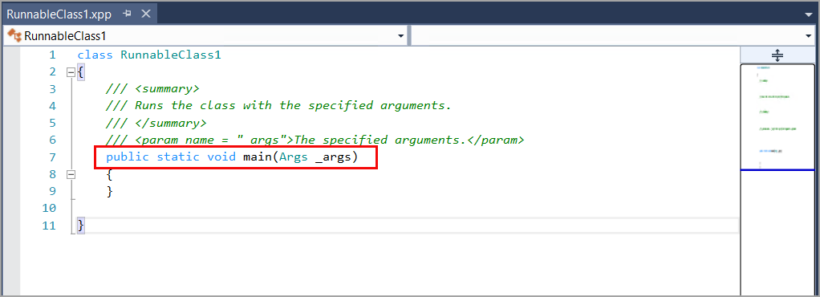
Add a Class to a Project
To add a class in Visual Studio, go to Solution Explorer, right-click your project, select Add > New Item, and choose either Class or Runnable Class (Job).
Notes:
A class is a software construct that expresses the data and methods of the objects, which are later constructed from that class. These objects are also referred to as instances. Data in a class defines the state of an object, and the methods in a class define the behavior of that object. Methods are a sequence of statements that operate on the data in a class.
Usually, methods are declared to operate on the instance variables of a class. These methods are referred to as instance or object methods. An instance variable is a variable that is bound within the instance or within an instantiated object, as opposed to a static or class variable that is bound to a class.
When you are creating a class, it is declared as public, even if you remove the public modifier. In addition to the public modifier, you can add the final and/or extends modifiers. Using the final modifier helps prevent the class from being inherited. The extends modifier is used when your class is derived from another class.
A runnable class for finance and operations apps, known previously as a job, is similar to a standard class, except that it contains a main method. You can manually add methods to your class, including a main method. Methods will be described in further detail in the next unit. The following screenshot shows the code editor window when you create a runnable class named RunnableClass1.

Slide 95
Add Code and Methods to Meet Business Requirements
Methods that you will encounter and create in development for finance and operations apps include:
New method
Finalize method
Main method
Instance method
Static method
X++
X++
X++
X++
X++
Sample mySample; //this declares a variable to refer to a sample object
mySample = new Sample(); //this creates an instance of a sample object
if (condition) //state the condition that should be met
{
this.finalize();
}
Static void main (Args _args)
{
//This comment represents where you would insert your code.
}
ClassName objectReference = new ClassName();
objectReference.methodname();
ClassName::methodName();
Notes:
Accessor keywords can be used to control whether the methods in other classes can call the methods in your class. Class inheritance is also affected by the following accessor keywords.
public - Methods declared as public can be called from anywhere that the class is accessible. A public method can be overridden by a subclass, unless that method is declared as final.
protected - Methods declared as protected can only be called from methods in the same class or methods in a subclass of that class. A protected method can still be overridden in a subclass.
private - Methods declared as private can only be called from methods within the same class. Unlike public and protected methods, private methods can't be overridden in a subclass.

Slide 96
Data Manipulation
You can write code to manipulate data that is stored in the database.
Use a select method to declare the data that will be modified.
An insert method is used to add one or more records to a table.
An update method is used to modify the current record in the appropriate system fields.
Use a where clause to specify a condition that the update method will test as it processes each row of the table.
A delete method is used to remove records from a table. Before using an update or delete method, you must use a select method to define the data that you will be updating or deleting.
To select multiple records or fields, you will initially use a select method and then use a next method to fetch the next record in a table.
To loop over many records that meet specific criteria, you can use a while select method.
Notes:
The following are code samples for insert, update, and delete methods. The samples use a fictitious MyCustomerTable table containing fictitious fields for AccountNumber and CustomerName.
insert method
//This will insert a new record into a sample MyCustomerTable table. The only mandatory field that is set on this table is AccountNumber.
private void AddCustomer()
{
MyCustomerTable myCustomerTable;
ttsBegin;
myCustomerTable.AccountNumber = "1234";
//The new record will have the account number 1234.
myCustomerTable.insert();
ttsCommit;
}
update method
//This will update the record where the AccountNumber field is set to 1234 by adding more information in the CustomerName field.
private void UpdateCustomer()
{
MyCustomerTable myCustomerTable
ttsBegin;
select forUpdate myCustomerTable
where myCustomerTable.AccountNumber == "1234";
//Now we will update the CustomerName field to be Sally
myCustomerTable.CustomerName = "Sally";
myCustomerTable.update();
ttsCommit;
}
delete method
//This will delete the record from the MyCustomerTable table where the AccountNumber field is set to 1234.
private void DeleteCustomer()
{
ttsBegin;
while select forUpdate myCustomerTable
where myCustomerTable.AccountNumber == "1234"
{
myCustomerTable.delete();
}
ttsCommit;
}

Slide 97
Exercise – Insert Records by Using a Runnable Class
Scenario: As the finance and operations apps developer, you have been tasked with inserting customer records into a table for your Fleet Management company. You need to create a runnable class and add code that will insert two records into the FMCustomer table.
Task 1: Read this first – Before you start the lab!
Task 2: Scenario
Task 3: Create a runnable class
Task 4: Add code to insert customer records
Task 5: Close the lab environment
Notes:
All exercises are optional.
Link is https://learn.microsoft.com/training/modules/create-classes-finance-operations/5-exercise

Slide 98
Knowledge Check
1
What method is automatically added when you're creating a runnable class instead of a class?
2
Which method will allow the method to be called from anywhere that its class is accessible?
3
You want to update a record in your SampleTable table that contains the account number 1234 by using the update method. Before you call the update method, what kind of clause is used at the beginning of this statement to locate the record sampleTable.AccountNum == “1234”?
Notes:
A main method: A main method is automatically added to a runnable class. Therefore, you would add a runnable class instead of a class to your project.
A public method: Methods that are declared as public can be called from anywhere that the class is accessible.
A where clause: where sampleTable.AccountNum == “1234”: A where clause is used to specify a condition that the update method will test as it processes each row of the SampleTable table.

Slide 99
Summary
After this module, you’ve learned:
X++ is an object-oriented programming language used for finance and operations apps.
Classes define an object’s state and behavior through data and methods.
Tables and forms contain classes that can be extended to add more methods.
Runnable classes contain an empty main method and can be added to a project through Visual Studio.
Links to related modules (and sites) for specific topics
Topic | Link
Overview of various class types and methods | Classes and methods
Data manipulation methods | X++ data selection and manipulation
Learn the basics of X++ | Get started with development using X++ in finance and operations apps
Notes:
https://learn.microsoft.com/dynamics365/fin-ops-core/dev-itpro/dev-ref/xpp-classes-methods
https://learn.microsoft.com/dynamics365/fin-ops-core/dev-itpro/dev-ref/xpp-data/xpp-data-home-page
https://learn.microsoft.com/training/modules/get-started-xpp-finance-operations/

Slide 100
Module 10: Build Reports
LP1
Learning Path 2
M1
M2
M3
M4
M5
M6
M7
M8
M9
Module 10
Notes:
Module link: https://learn.microsoft.com/training/modules/build-reports-finance-operations/

Slide 101
Objectives
In this module, you will:
1
Enable Business document management.
2
Design, create, and modify SSRS reports.
3
Create and modify a Power BI report by using finance and operations apps data.
4
Create and modify an Excel report by using finance and operations apps data.
5
Learn how to build SQL statement by using query objects.

Slide 102
Implement Business Document Management
Business document management allows for creating and editing output documents like invoices without relying on SQL Server Reporting Services (SSRS) report development.
It supports output to Microsoft Word, Microsoft Excel, and PDF.
Users can modify templates without needing to complete source code changes and new deployments.
The tool is dependent on the Electronic reporting framework and uses the Print management framework to link the custom document to the printing option.
Access permissions can be set up to restrict users’ access to templates.

Slide 103
Create and Modify Reports that Use SSRS
SSRS reports allow for printing to different locations, creating parameterized views with drill-down navigation, embedding hyperlinks, and scheduling reports to run periodically, and can be used to create compliance documents, while also allowing for the creation and modification of reports using X++ development.
Design SSRS reports
Consider needed data when designing a report
SSRS is suitable for high-volume transaction-focused reports for email, print, archive, and bulk distribution
Autodesign is useful for simple reports while precision designer is for complex ones
Precision designer allows customization of layout and content
Fields, tables, margins, spacing, expressions, fonts, logos, and labels can be added
Create SSRS reports
Creating a report requires Microsoft Visual Studio and a finance and operations apps development environment.
A data set must be assigned to the report, which defines what data is used.
Four types of data sources are available: Query, business logic, report data provider (RDP), and AX enum provider.
The finished report must be deployed before it can be run in finance and operations apps.
Modify SSRS reports
Modify existing report using X++ objects in Visual Studio.
Use extensions on tables or report data provider classes to add new columns.
Extend menu items and other classes to redirect navigation to custom designed reports.
Extending reports allows changes without affecting standard report solutions.

Slide 104
Implement Query Objects and Query Builder: QBDS
X++
class TrainingMasterQuery
{
public static void main(Args _args)
{
QueryBuildDataSource qbds;
Query query = new Query();
qbds = query.addDataSource(tableNum(TrainingMaster)); qbds.addSortField(fieldNum(TrainingMaster, TrainingID), SortOrder::Ascending);
QueryRun queryRun = new QueryRun(query);
while (queryRun.next())
{
TrainingMaster trainingMaster = queryRun.get(tableNum(TrainingMaster));
info(strFmt("%1, %2", trainingMaster.TrainingID, date2Str(trainingMaster.TrainingDate, 123, DateDay::Digits1or2, DateSeparator::Hyphen, DateMonth::Digits1or2, DateSeparator::Hyphen, DateYear::Digits4)));
}
}
}
QueryBuildDataSource class
The QueryBuildDataSource class is the building block for creating the query.
It defines the data source to be added to the query. It can specify the table fields to be added, sort order of the records, and so on.
Additionally, it can establish the relationship by applying joins between data sources.
Example on the right →

Slide 105
Implement Query Objects and Query Builder: QBR
X++
class TrainingMasterQuery
{
public static void main(Args _args)
{
Query query = new Query();
QueryBuildDataSource qbds = query.addDataSource(tableNum(TrainingMaster)); qbds.addSortField(fieldNum(TrainingMaster, TrainingID), SortOrder::Ascending);
QueryBuildRange qbr = qbds.addRange(fieldNum(TrainingMaster, TrainingType));
qbr.value(queryValue(TrainingType::Online));
QueryRun queryRun = new QueryRun(query);
while (queryRun.next())
{
TrainingMaster trainingMaster = queryRun.get(tableNum(TrainingMaster));
info(strFmt("%1, %2", trainingMaster.TrainingID, date2Str(trainingMaster.TrainingDate, 123, DateDay::Digits1or2, DateSeparator::Hyphen, DateMonth::Digits1or2, DateSeparator::Hyphen, DateYear::Digits4)));
}
}
}
QueryBuildRange class
The QueryBuildRange class defines filtering for the records that are fetched from the data source.
Example on the right →

Slide 106
Implement Query Objects and Query Builder – Syntax
X++
class TrainingMasterQuery
{
public static void main(Args _args)
{
Query query = new Query();
QueryBuildDataSource qbds1 = query.addDataSource(tableNum(TrainingMaster)); qbds1.addSortField(fieldNum(TrainingMaster, TrainingID), SortOrder::Ascending);
QueryBuildRange qbr1 = qbds1.addRange(fieldNum(TrainingMaster, NoofDays));
qbr1.value(queryValue(">2"));
QueryRun queryRun = new QueryRun(query);
while (queryRun.next())
{
TrainingMaster trainingMaster = queryRun.get(tableNum(TrainingMaster));
info(strFmt("%1, %2", trainingMaster.TrainingID, date2Str(trainingMaster.TrainingDate, 123, DateDay::Digits1or2, DateSeparator::Hyphen, DateMonth::Digits1or2, DateSeparator::Hyphen, DateYear::Digits4)));
}
}
}
Advanced query syntax
A range of advanced query syntax exists for string, number, or date fields
For string fields, you can filter by equal, not equal, range, wildcard, and so on.
For number fields, the filter options can be equal, not equal, greater than, less than, and so on.
For date fields, the filter options can be day-based, day range, month range, year range, greater/less than dates, and so on.
Example on the right →

Slide 107
Implement Query Objects and Query Builder – Joins
X++
class TrainingMasterQuery {
public static void main(Args _args) {
Query query = new Query();
QueryBuildDataSource qbds1 = query.addDataSource(tableNum(TrainingMaster)); qbds1.addSortField(fieldNum(TrainingMaster, TrainingID), SortOrder::Ascending);
QueryBuildRange qbr1 = qbds1.addRange(fieldNum(TrainingMaster, TrainingType));
qbr1.value(queryValue(TrainingType::Online));
QueryBuildDataSource qbds2 = qbds1.addDataSource(tableNum(TrainerTable));
qbds2.relations(true);
qbds2.joinMode(JoinMode::ExistsJoin);
QueryBuildRange qbr2 = qbds2.addRange(fieldNum(TrainerTable, TrainerType));
qbr2.value(queryValue(TrainerType::Technical));
QueryRun queryRun = new QueryRun(query);
while (queryRun.next()) {
TrainingMaster trainingMaster = queryRun.get(tableNum(TrainingMaster));
info(strFmt("%1, %2", trainingMaster.TrainingID, date2Str(trainingMaster.TrainingDate, 123, DateDay::Digits1or2, DateSeparator::Hyphen, DateMonth::Digits1or2, DateSeparator::Hyphen, DateYear::Digits4))); } } }
Build a query that includes a relational tables
By using a query object, you can build a query that includes related tables.
You can define all types of joins as required by your query.
Example on the right →
Notes:
For more information about query objects and the query builder, see the following sites:
Advanced filtering and query syntax
QueryBuildDataSource Class
How to: Create Queries by Using X++
The Query object model section

Slide 108
Create and Modify Reports by Using Power BI
Create a Power BI report with finance and operations apps data
Modify a Power BI report
To create a report for Dynamics 365 Unified Operations data, you will need to use Visual Studio and Power BI Online or Power BI Desktop.
Power BI connects to the data using OData endpoints.
You can manipulate the data by dragging fields and choosing visualizations.
The finished report can then be pushed to the production environment.
Power BI can be used for quick and simple manipulation of how your data is viewed.
You can adjust existing reports to filter data as you need it.

Slide 109
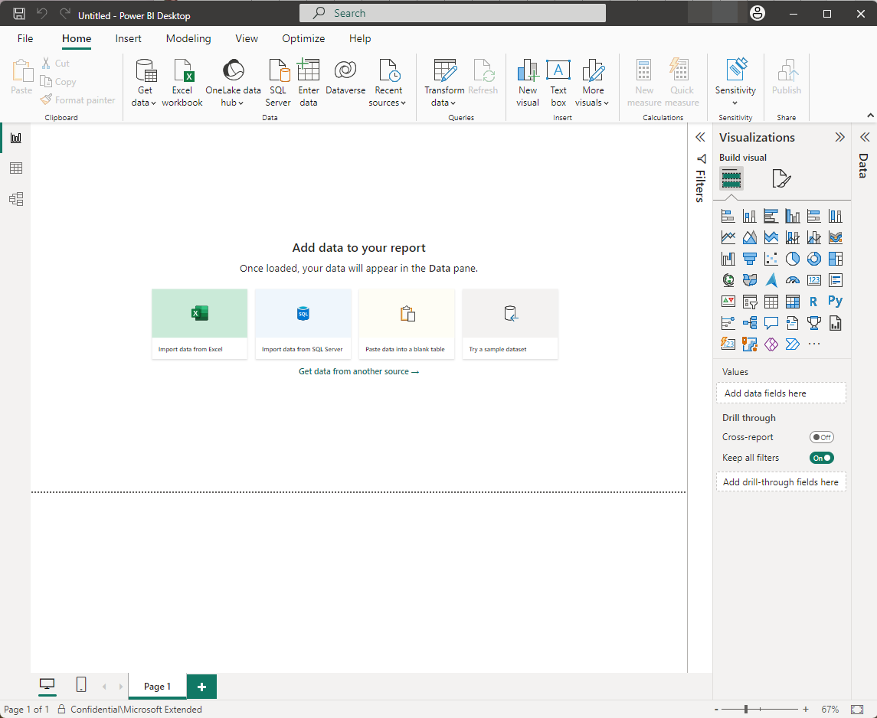
Demo – Connect to your Data by Using Power BI
Create a Power BI report with finance and operations apps data
DEMO
Watch the video to learn how to connect to your data in finance and operations by using Power BI:
Notes:
https://www.microsoft.com/videoplayer/embed/RE4byCi?postJsllMsg=true

Slide 110
Create and Modify Reports by Using Excel
Excel can be used for viewing and analyzing transactional data, and Finance and Operations uses an Excel Data Connector to view, update, and edit data within an Excel workbook.
The Open in Excel feature lets you change data in the grid and publish the changes back to Finance and Operations apps, while the Export to Excel feature exports all the grid data to an Excel workbook.
To optimize queries for SSRS and Power BI reports, make sure to pull only necessary data and avoid excessive slicers.
Grouping and expressions can help organize and format data on reports, and labels can automatically translate text to multiple languages.
Additional properties for SSRS reports can control the font, style, and margin sizes of text to make it more readable.

Slide 111
Exercise – Create and Deploy a Report
Exercise 1: Exercise – Create and deploy a report
Task 1: Create a query
Task 2: Create the report.
Task 3: Create a menu item to run the report.
Task 4: Run the report.
Notes:
All exercises are optional.
Link is https://learn.microsoft.com/training/modules/build-reports-finance-operations/04-exercise

Slide 112
Knowledge Check
1
What data source types can you use when creating a report?
Query
Business logic
RDP class
AX enum provider
All the above
2
What does the function Open in Excel do that Export to Excel does not?
3
A report is taking a long time to run. When looking at the query, you notice that several fields are not being used in the report. To optimize this report, how should these unused fields be handled to increase performance?
Notes:
All of the above: Query, business logic, RDP class, and AX enum provider are the data source types that you can select.
Open in Excel uses data entities that let you publish changes to the data back to finance and operations: Export to Excel uses the grid data and does not give you the option to publish data back to finance and operations.
Remove the unused fields from the report: Removing any unused fields from the report can help the performance of the report.

Slide 113
Summary
In this module, you learned:
How to create and modify SSRS reports, Power BI reports, and Excel reports by using finance and operations apps data.

Slide 114
Module 11: Build Workspaces
LP1
Learning Path 2
M1
M2
M3
M4
M5
M6
M7
M8
M9
M10
Module 11
Notes:
Module link: https://learn.microsoft.com/training/modules/build-workspaces-finance-operations/

Slide 115
Objectives
In this module, you will:
1
Design and build key performance indicators (KPIs).
2
Create workspace elements.
3
Use Report Definition Language (RDL) to create custom reports.
4
Implement reporting components into workspaces.

Slide 116
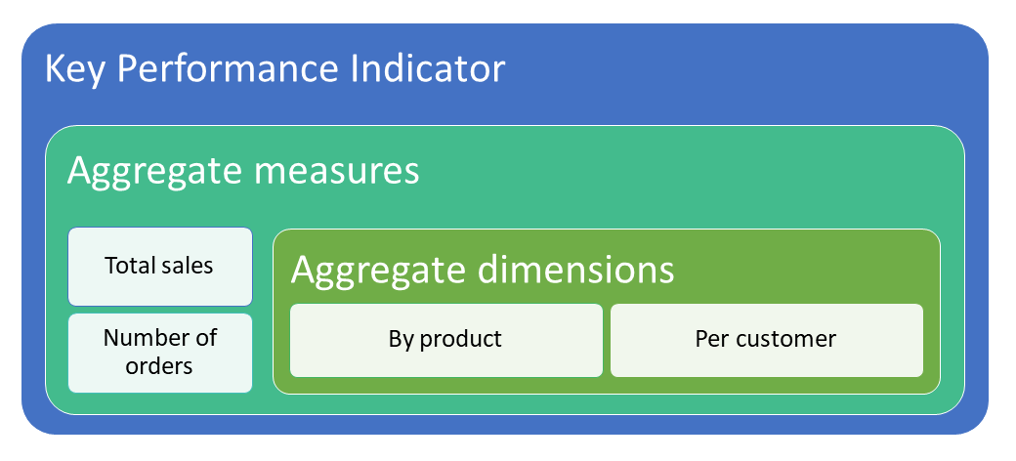
Design KPIs – About
KPIs provide measurable values to track business performance.
KPIs should have clear objectives and be periodically reviewed.
Aggregate data can be used to create KPIs, with measures like total sales.
Aggregate measurements can be set to measure different properties.
Two ways to deploy aggregate measurements are InMemoryRealTime and StagedEntityStore.
Dimensions are slicers used to analyze data.
Aggregate data can be used to define KPIs using X++.
KPIs can be customized by users at run time.

Slide 117
Design KPIs – Steps
Steps on how to design KPIs:
Create a new project in Visual studio
Create aggregate measurements
Create aggregate dimensions
Create model dimension references
Deploy aggregate measurements
Create the aggregate data entity
Create a KPI
Add the KPI to a workspace
Notes:
Create a new project in Visual studio
To create a new project in Visual studio, follow these steps:
Open Visual Studio as an Administrator and under Get started, select Create a new project.
In the search box, type Finance Operation and select the template for finance and operations project and select Next.
Name your Project NewKPI and select Create at the bottom of the page. This will create your NewKPI project.
Create aggregate measurements
To create aggregate measurements, follow these steps:
In the Solution explorer, right-click your project and select Add New > New item.
Under Dynamics 365 Items select Analytics > Aggregate Measurement.
Open Application Explorer by going to View > Application Explorer if it does not already show up on your page.
Go to Data Model > Views and select the FMVehicleExtendedView view to create measurements. Because the project model is Fleet Management the FMVehicleExtendedView view is compatible.
Drag and drop the FMVehicleExtendedView view in the MeasureGroup1 group for the Aggregate measure.
In the Dimensions group, right click on Date and select Delete.
In the Application Explorer, right click the FMVehicleExtendedView and select Open designer. Split the resulting pane alongside the Design pane for your AggregateMeasurement object.
Drag and drop the Mileage field from the view to the Measures group in your AggregateMeasurement.
Each measure has a default Aggregate property that you can set:
Count
Sum
AverageOfChildren
DistinctCount
Max
Min
Save all, and then build the project to see if it compiles correctly. This can be done by right clicking the project and selecting Build.
Create aggregate dimensions
To create aggregate dimensions, follow these steps:
In the Solution explorer, right-click your project and select Add New > New Item.
Under Dynamics 365 Items select Analytics > Aggregate Dimension, and then select Add.
In the Application Explorer, go to Data model > Views and select the **FMVehicleExtendedView ** view to pull measurements.
Drag the selected item onto the root of the AggregateDimensions object that you’ve created.
There may be automatically created attributes in the Attributes group of your dimension. Delete these or change the Dimension field property to Model.
If you don’t have an attribute or didn’t change the Dimension field on the original attribute, drag the Model field from the view into Aggregate dimension > Attributes.
Save all, and then build the project to see if it compiles correctly. This can be done by right clicking the project and selecting Build.
Create model dimension references
To create model dimension references, follow these steps:
From the Solution Explorer, drag and drop the Aggregate dimension into the Aggregate measurement's Dimension node in the middle of the page.
Right-click the Dimension node and select New Dimension, and rename the new dimension.
Select the newly created dimension, and then right-click and select New relation.
Name the new relation and change the Dimension attribute to Model.
In the child node, set the Related field property to Model.
Save all and Build.
Deploy aggregate measurements
To deploy aggregate measurements, follow these steps:
Select the aggregate measurement.
Set the Usage property in Properties:
InMemoryRealTime
StagedEntityStore
Right-click the aggregate measurement in the Solution Explorer, and select Add Column Store Indices.
Create the aggregate data entity
To create the aggregate data entity, follow these steps:
In the Solution explorer, right-click your project and select Add new > New item.
Under Dynamics 365 items select Analytics > Aggregate Data Entity.
Select Add.
Drag and drop the aggregate measure from the Solution Explorer to the data source of the aggregate data entity shown on the Designer Window.
In the data source, expand the DataSource, expand the Aggregate data measurement, expand the measure group (Mileage), and Measures, and then drag Mileage into Fields.
In the data source, expand the DataSource, expand the Aggregate data measurement, Expand the measure group (Mileage), and Dimensions, then drag AggregateDimension into Fields.
Right-click on the added field and open Properties.
In Properties, go to the Attribute property in the Data section. Set the attribute value to any value.
Save and build the solution.
Create a KPI
To create a KPI, follow these steps:
Right-click the project and select Add > New Item.
Under Dynamics 365 items select Analytics > Key Performance Indicator.
Select Add.
Set the Measurement property to select the measurement for the KPI in the Properties section.
Select the Value node of the KPI.
Set the measurement group on the Measure group property.
Set the measure on the Measure property.
Select the Goal node of the KPI.
Set the Goal Type property to BasedOnMeasure.
Set the measurement group on the Measure group property.
Set the measure on the Measure property.
Select Save and Build.
Add the KPI to a workspace
To add the KPI to a workspace, follow these steps:
Right-click the project and select Add > New item.
Select User Interface > Tile.
Select Add.
Drag and drop the KPI from Solution explorer onto the tile in the Tile designer.
Save.
Create an extension of an existing workspace form or create a new workspace form. Ensure the solution model matches the workspace form model, otherwise you cannot make an extension of that form. Create an extension by right-clicking on the form in the AOT.
In the Designer, add a Tile button. You may need to change the pattern of the form to custom to do this.
Set the Tile property drop-down option to the KPI tile that you created.
Save all and build the solution.
The workspace will show the new KPI that was created. Select the KPI tile to view details.

Slide 118
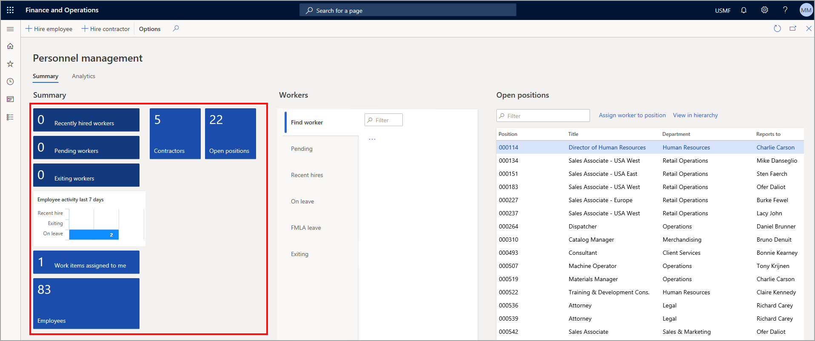
Create Drill-through Workspace Elements
Drill-through elements allow for more detailed data views within a workspace.
Tiles are buttons that display data and can provide drill-through access.
Tiles can be created and added to workspaces through X++ development.
To add a tile button to a workspace in the user interface, personalize the workspace and select “Add to workspace” in the Action Pane.
To add a tile button to an existing workspace in the developer environment, create an extension form and add a new control for the tile button.
Notes:
Add a tile button to your workspace in the user interface
To add a Tile button to your workspace in the user interface, follow these steps:
Right-click the dashboard below the header image and select Personalize.
Select the +Add a workspace button. A new workspace will be created, titled My Workspace 1.
Right-click My Workspace 1 and enter a new name for your workspace.
Open the navigation pane and go to Modules > Accounts Receivable > Customers > All customers.
On the Action Pane, select the Options tab.
In the Personalize button group, select Add to workspace.
In the Workspace drop-down menu, select your workspace.
In the Presentation drop-down menu, select Tile.
Select Configure.
In the Add as list pane, keep all defaults and select OK.
Select the finance and operations button to return to the dashboard.
Select your workspace. The tile now shows the properties that you configured.
Add a tile button to an existing workspace in the developer environment
To add a Tile button to an existing workspace, follow these steps:
Create a new project in Visual Studio and make sure that the model that your project is in references "Fleet Management." Verify that the model that your project is in references "Fleet Management" by following these steps:
Select the Dynamics 365 menu.
Select Model management > Update model parameters.
Select the model that you are using in the Model name drop-down list.
Select Next.
Ensure that the Fleet Management model is selected in the References models screen.
With the new project open in the Solution Explorer, right-click the project and select Add > New item.
In the Add new item window, select User Interface on the left pane.
Select Tile on the middle pane.
Name the new tile MyTile.
Select Add.
In the Properties window for the new MyTile object, select Wide in the Size field.
Select My Tile in the Label field.
Select Display in the Menu item type field.
Select FMSetup in the Menu item name field.
Select Save.
By linking this tile to the FMSetup menu display item, when the tile is selected in the application, it will open the Fleet Management Setup page.
Now, you will extend the Reservation management workspace and add the tile to the Summary section.
In Application Explorer, find the FMClerkWorkspace page.
Right-click FMClerkWorkspace and select Create extension.
A new form is added to your project called FMClerkWorkspace.Extension.
Right-click FMClerkWorkspace.Extension, select Rename, and rename the object to FMClerkWorkspace.myExtension.
Double-click FMClerkWorkspace.myExtension to open it in the element designer.
On the design pane of the form designer, open FormTabControl1 > Workspace > PanoramaBody > SummaryTileSection.
Right-click SummaryTileSection and select New > Tile button.
A new control will be added to the form called TileButtonControl1.
Select TileButtonControl1 and go to the properties window.
Select MyTile in the Name field.
Select MyTile in the Tile field.
Select My Tile in the Tile text field.
Save and build the project.
To view the new tile, open finance and operations apps, and go to the Reservation management workspace. The tile should display in the Summary section.

Slide 119
Create Custom Reusable Report Functions by Using RDL
Report Definition Language (RDL) is an XML representation of an SSRS report definition that contains data retrieval and layout information for a report.
Custom functions can be added through code assemblies within report definition files.
RDL can define charts, graphs, calculations, text, images, and other report objects.
Reports created by RDL can be exported as .rdl files, which contain report data, calculations, and layout.
All SSRS reports generate a .rdl file.

Slide 120
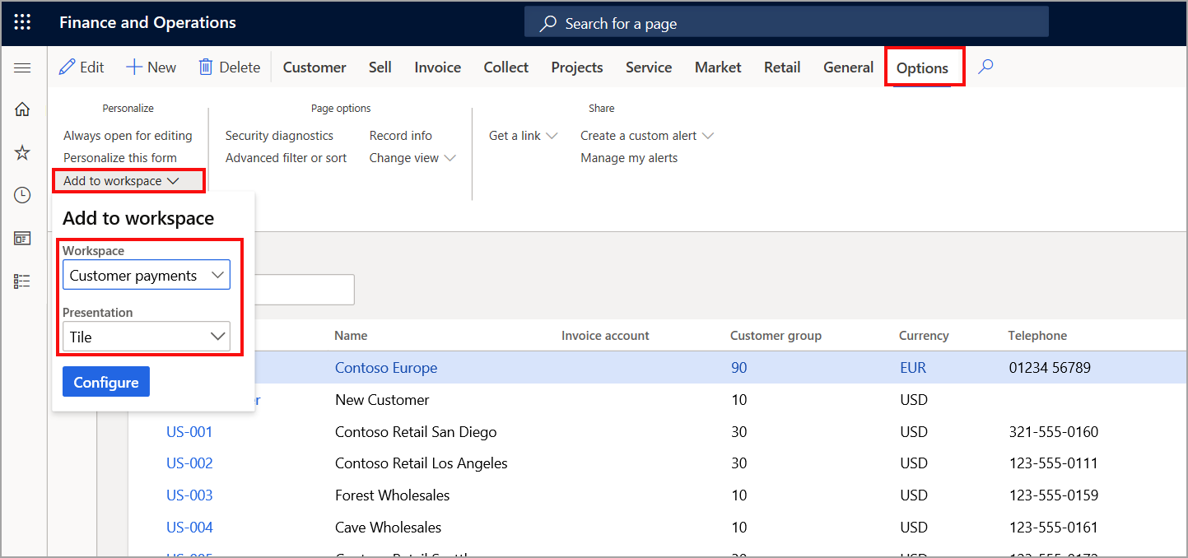
Implement Built-in KPIs, Charts, and Other Reporting Components
Workspaces in finance and operations apps can contain various elements, including KPIs, charts, and other components.
Users can add existing elements to a workspace from the user interface and choose presentation types such as Tile, List, or Link.
In the developer environment, KPI tiles can display calculated measures and Power BI reports can be embedded in the workspace.
Creating KPIs involves defining KPI range, goals, and/or trends, creating a tile for the KPI, and adding the KPI to the tile.
Users can customize KPIs at runtime.
You can also embed Power BI reports into your workspace

Slide 121
Exercise – Create a Workspace and Add a Tile, List, Link, and Power BI Element
Exercise 1: Create a workspace and add a tile, list, link, and Power BI element
Task 1: Scenario:
Task 2: Create a new workspace
Task 3: Add a tile to your workspace
Task 4: Add a list to your workspace
Task 5: Add a link to your workspace
Task 6: Embed a Power BI report
Notes:
All exercises are optional.
Link is https://learn.microsoft.com/training/modules/build-workspaces-finance-operations/5-exercise

Slide 122
Knowledge Check
1
Why would a KPI need to be used by a business?
2
You want to add an element to your workspace to quickly see sales orders that have been marked as Pending confirmation. Normally, you filter the Sales order list page to find if you have any orders that are waiting for confirmation. What workspace element would help you quickly identify the pending confirmation orders that you must process?
3
What are the benefits of using a workspace?
Users can create and edit workspaces through the user interface without the need of a developer.
Workspaces can be personalized and shared across users.
You can embed Power BI reports to generate data visualizations.
Workspaces let users work from one location to view required data in one location.
All of the above
Notes:
KPIs can be used to measure performance: KPIs are measurable values that are used to measure performance.
Tile: A tile would give you a record count of all the orders that are pending confirmation. You can then select the tile to take you to a filtered view of the pending confirmation orders.
All of the above statements are benefits of a workspace.

Slide 123
Summary
In this module, you learned:
The steps and information necessary to design, create, and modify these workspaces to work for your business, and to provide users with what they need.

Slide 124
Module 12: Implement Role-based Security
LP1
Learning Path 2
M1
M2
M3
M4
M5
M6
M7
M8
M9
M10
M11
Module 12
Notes:
Module link: https://learn.microsoft.com/training/modules/role-security-finance-operations/

Slide 125
Objectives
In this module, you will:
1
Create and modify roles, duties, privileges, and permissions.
2
Review the role-based security hierarchy.
3
Use and enforce permissions policies.
4
Define the extensible data security framework (XDS).
5
Apply security permissions.
6
Stay compliant with user licensing requirements.

Slide 126
Introduction
Role-based security is used to grant access to finance and operations apps based on security roles assigned to users.
Users must have an authenticated Microsoft Azure Active Directory (Azure AD) account to be assigned a role and access the apps.
Security roles are aligned with the organization’s structure and are based on daily job responsibilities.
Roles contain duties, privileges, and permissions that control access to system components.
Business managers can control user access as their business needs change after security roles, duties, and privileges have been set up.

Slide 127
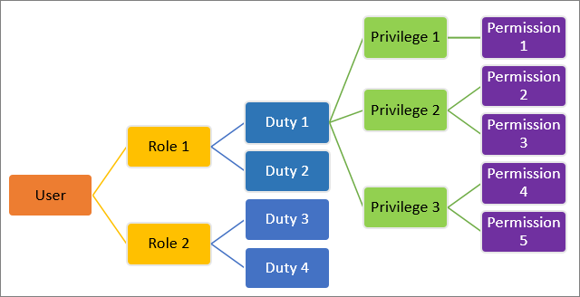
Create and Modify Duties, Privileges, and Permissions
Finance and operations apps come with predefined roles, duties, privileges, and permissions.
New roles, duties, privileges, or permissions can be created in Visual Studio.
Security roles should be managed by a system administrator in Visual Studio.
Permissions are the most granular access to the apps and are assigned within privileges.
Privileges are composed of permissions and represent tasks, while duties are composed of privileges and represent parts of a business process.
Roles apply across all companies and organizations but can be specified for a user in a role.
Notes:
Create new roles, duties, and privileges
In Visual Studio, you can create new roles, duties, and privileges by adding an item to your project in the Solution Explorer window. Additionally, you can create new permissions directly through a privilege in the element designer window.
Two ways to assign duties to a role are:
Add a new duty within the Duties node of the role in the element designer window.
Select a duty from the Application Object Tree (AOT) and drag it to the Duties node in the element designer window. This same process applies to assigning privileges to roles. You can also create an extension of an existing role, duty, or privilege. This would allow you to add or remove a duty from a role, or perhaps change a view-only privilege to an edit privilege for a certain page in finance and operations apps.
Follow these steps to create a new security element:
In Visual Studio, go to the Solution Explorer window.
Right-click your project and select Add > New Item.
In the left column, under the Dynamics 365 Items node, select Security.
Select Security Role, Security Duty, or Security Privilege, depending on the type of element that you need to create.
Enter a Name for the security element.
Select Add to add this element to your project. The element will now be open in the element designer window.

Slide 128
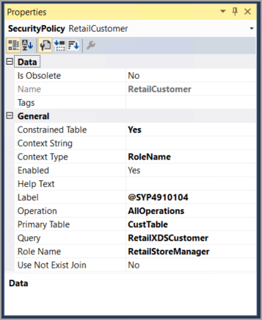
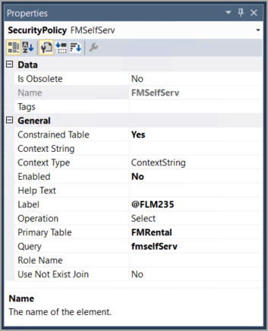
Enforce Permissions Policy
Permissions policies are used in role-based security to grant users access for specific purposes.
Queries are used to specify criteria for returned records and field security profiles can be created to restrict access to certain fields.
Permissions policies can be added through the Solution Explorer window and can specify details such as the query, Primary Table, and Context Type. They can be used to grant access to various areas of finance and operations apps.
Notes:
The image in slide on the left side shows the Properties window of the RetailCustomer security policy that uses the RoleName context type. The Role Name property has been filled in to specify that the RetailStoreManager role is associated with this policy.
The image in slide on the right side is the Properties window of the FMSelfServ security policy that uses the ContextString context type. Notice that different fields are used as you select a different context type.

Slide 129
Extensible Data Security Framework
Introduction of extensible data security (XDS) framework.
The flow for an XDS policy is as follows:
Authorization is used to grant access to tables, fields, and rows in finance and operations apps user interface.
Data security is used to restrict or deny access to those elements.
The extensible data security (XDS) framework is used to assign data security policies to security roles.
XDS is an evolution of record-level security (RLS) that allows the administrators to secure data in shared tables.
XDS policies are enforced regardless of how the data is being accessed.
Start with a query to define the filters or limits that should be placed on the primary table or tables.
Create a security policy that links to the query and primary table for which you want to restrict data access.
Define the context for the rule. This could be based on a string, which would require additional development, or based on a role or group of roles.
Define the list of constrained tables, which are related tables that store data from the primary tables for which you are attempting to restrict a subset of data.

Slide 130
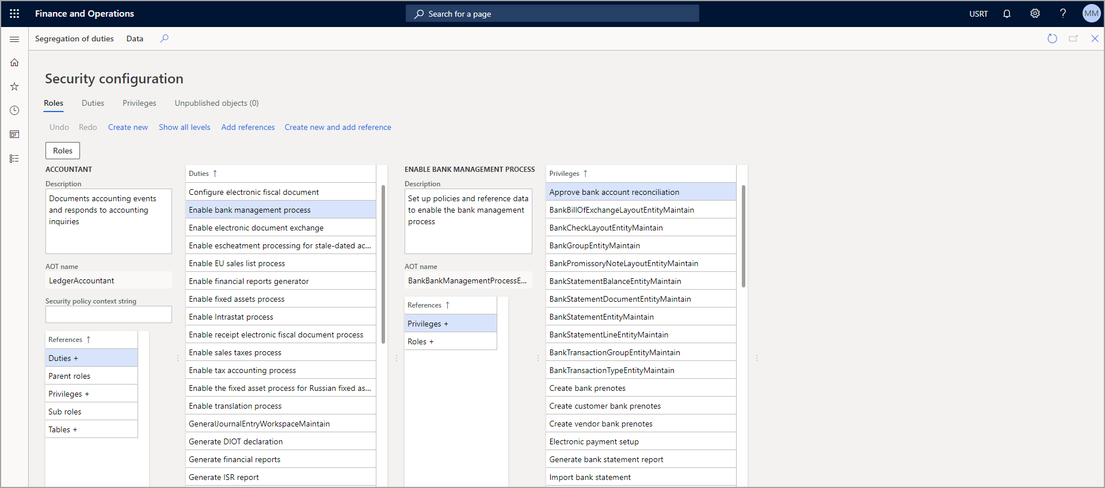
Apply Security Permissions
Users are assigned to security roles in the System administration module in finance and operations apps by going to Security administration > Security > Security configuration.
Notes:
You can automatically assign users to roles by using queries from Visual Studio, or you can manually assign an individual user to a role. Additionally, you can choose to have a user excluded from automatic role assignment by resetting her or his status.
Follow these steps to assign users to roles automatically:
In finance and operations apps, open the Navigation pane by selecting the menu icon in the top-left corner of the page.
Under the Modules node, select System administration.
Select Security to expand the node, and then select Assign users to roles.
In the left column, select the role that you want to assign users to, such as Accounts payable clerk.
In the middle column, beneath the Rules for dynamically assigning users to role heading, select Add rule.
Select your desired query name for the rule, such as LedgerJournalPostControl.
To modify the query, such as removing a company from the rule or adding a table join, select Edit query.
In the Action Pane, select Run automatic role assignment. You will see the users that have been added in the middle column under the Users assigned to role heading.

Slide 131
Exercise – Create a New Security Role and Add Duties
Scenario: The finance and operations apps developer has been asked by the Fleet Management company to create a new role based on a new position that they are filling for a Fleet Service Manager. The manager needs duties to manage cars and customers, as well as the basic duties that are associated with Fleet Management.
Task 1: Read this first – Before you start the lab!
Task 2: Scenario
Task 3: Create a new project
Task 4: Create the FMServiceManager role
Task 5: Create the FMServiceManager role
Task 6: Close the lab environment
Notes:
All exercises are optional.
Link is https://learn.microsoft.com/training/modules/role-security-finance-operations/6-exercise

Slide 132
Implement authorization to support integration
Data management framework's package API uses OAuth 2.0 for authorization.
Register the application with Microsoft Entra ID through the Azure portal.
OAuth 2.0 authorization code request flow:
Client directs the user to the /authorize endpoint.
User signs in and grants consent.
Microsoft Entra ID sends a response to the application at the redirect_uri address.
Two types of responses: Successful response and Error response.
Successful response grants access and provides an authorization code.
Authorization code is redeemed for an access token by sending a POST request to the /token endpoint.
Azure AD returns an access token (JWT).
Cache access tokens for the specified token lifetime.
Use the access token in requests to web APIs.
When the user authenticates and grants consent, Microsoft Entra ID will send a response to your application at the redirect_uri address in your request, as follows.
OData
// Line breaks for legibility only
https://login.microsoftonline.com/{tenant}/oauth2/authorize?
client_id=6731de76-14a6-49ae-97bc-6eba6914391e &response_type=code &redirect_uri=http%3A%2F%2Flocalhost%3A12345 &response_mode=query &resource=https%3A%2F%2Fservice.contoso.com%2F &state=12345

Slide 133
Knowledge Check
1
Which security element would be used to grant access to a specific menu item or field in finance and operations apps?
2
Which security element is assigned directly to a user and represents the least granular security control?
3
What framework is used to assign data security policies to security roles in finance and operations apps?
Notes:
Permission: Permissions are the most granular security element, and they are used to grant access to specific menu items, fields, and tables.
Role: A role is assigned directly to a user. All other security elements such as duties, privileges, and permissions are contained within the role.
The extensible data security (XDS) framework is used to assign data security policies to security roles, which deny access to a certain table, row, or field.

Slide 134
Summary
In this module, you learned:
The security structure in finance and operations apps is role-based, and all users must be assigned a role to gain access to the application.
Role-based security uses a hierarchy, with permissions representing the most granular security control and roles representing the least granular control.
Permissions are assigned to privileges, privileges are assigned to duties, and duties are assigned to roles.
New roles, duties, privileges, and permissions are created in Visual Studio.
Data security policy using XDS framework.
Security permissions policies define access to various parts of the system and are created based on queries.
Notes:
Links to related modules (and sites) for specific topics
Topic: Role-based security overview
Link: Role-based security

Slide 135
Module 13: Apply Basic Performance Optimization
LP1
Learning Path 2
M1
M2
M3
M4
M5
M6
M7
M8
M9
M10
M11
M12
Module 13
Notes:
Module link: https://learn.microsoft.com/training/modules/apply-basic-performance-optimization-finance-operations/

Slide 136
Objectives
In this module, you will:
1
Discover what temporary tables are and when to use them.
2
Learn about what set-based statements and row-based operations are, and when to use each.
3
Understand and demonstrate different methods for optimizing custom queries.
4
Learn about the different caching methods that are possible and when each should be used.

Slide 137
Introduction
People use computers for accuracy and speed in completing tasks.
Slow computer performance can be frustrating and decrease productivity.
Optimal computer performance is important in any project, especially for finance and operations apps.
Developers should prioritize optimizing performance in their designs to increase user appreciation and value.

Slide 138
Identify and Apply Caching Mechanisms
Caching data reduces loading times by decreasing calls to the database. Two types of caching are:
Set-based caching – Caches groups of records all at once. To implement set-based caching, you would need to set the CacheLookup property to EntireTable, but set-based caching should be avoided for large tables.
Single-record caching – Caches a single record at a time. Two conditions must be met to use single-record caching.
The CacheLookup property must be set to NotInTTS, Found, or FoundAndEmpty.
The record buffer disableCache method does not return true.

Slide 139
Create cached display methods
Used for calculated methods.
Improve performance since it’s only calculated once and when received from cache.
Can be enabled by X++ with cacheAddMethod
Can be enabled by attribute [SysClientCacheDataMethodAttribute] on the display method.
The following code example shows how to add a display method to the cache on a form:
X++
public void init() {
super();
this.cacheAddMethod(tableMethodStr(CustTable,
myDisplayMethod));
}

Slide 140
Optimize Temporary Table Usage
Explanation of temporary tables
Different types of temporary table
When they should be used?
Notes:
Explanation of temporary tables:
Temporary tables can efficiently create and clean up temporary data.
Different types of temporary table:
There are two types of temporary tables - InMemory and TempDB.
When they should be used?
InMemory tables use an indexed sequential access method (ISAM) file, while TempDB tables use the TempDB database of the SQL Server.
InMemory tables are useful for storing and retrieving data without writing it to the database, while TempDB tables are commonly used on reports to manipulate data. Both types of tables have limitations and capabilities, and the choice of table type depends on the specific use case.

Slide 141
When to Use Set-based Statements and Row-based Operations
Set-based statements are used to update, insert, or delete multiple records of data from a table.
Using set-based queries can greatly increase performance by reducing the number of calls that are made to the database.
Set-based statement only calls the database once.
Example of Update_recordset
Example of Delete_from
Example of Insert_recordset
X++
X++
X++
CustTable custTable;
Update_recordset custTable
Setting
PaymMode = 'Check’,
Currency = 'USD’
Where custTable.CustGroup == 'US';
CustTable custTable;
Delete_from custTable
Where custTable.CustGroup == 'US';
CustTable custTable; CustCustomerBaseStaging custCustomerBaseStaging;
Insert_recordset custTable (accountNum, custGroup, paymMode, currency)
Select CustomerAccount, CustomerGroupId, PaymentMethod,SalesCurrencyCode
From custCustomerBaseStaging
Where custCustomerBaseStaging.CustGroupID == 'US';

Slide 142
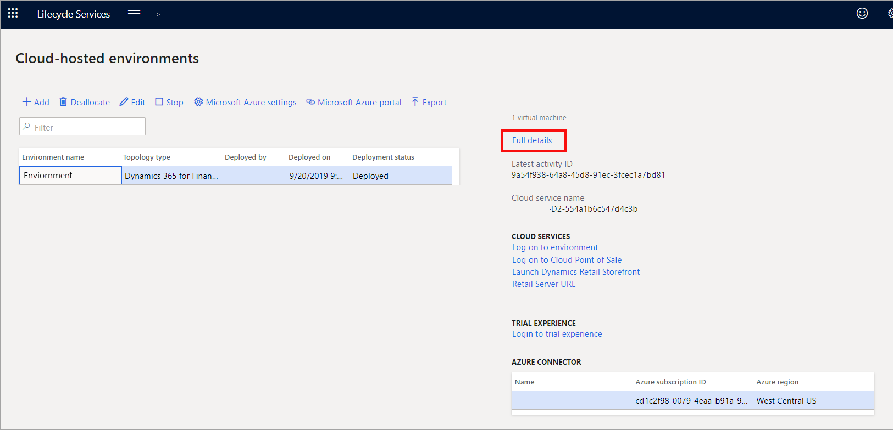
Query Optimization Principles
Poorly created queries can negatively impact performance.
Queries should only pull the necessary data and fields.
Avoid nested queries and use appropriate joins(Join, Outer join, Exists join and Notexists join).
Use index and index hint to sort data on large and rapidly growing tables.
Tools such as Optimization Advisor and Lifecycle Services can help monitor and optimize performance.
Notes:
Poorly created queries can cause performance issues. You can apply a few best practices to queries to avoid unnecessary impacts on performance.
All queries should pull only the required data needed - Your queries should pull from a defined list of fields. For example, if you need to pull a customer’s account number, you should limit your query to only pull the Account number field. Pulling unnecessary fields will decrease performance.
Avoid nested queries - Nested queries are queries within a query. For example, a nested query occurs if you create a query to pull the Customer table and then create a second query to pull the Sales table based on the first query. Instead, use a join to link the two tables into a single query.
The four types of joins that you can make with select queries are:
Join - The standard join pulls records that match on both tables, like an inner join.
Outer join - This join pulls records regardless of whether those records match on both tables.
Exists join - This join pulls all the records from the first table that match the records in the second table. No records from the second table are returned.
Notexists join - This join pulls all the records from the first table that do not match the records in the second table. No records from the second table are returned.
Using the appropriate join can increase performance by reducing the number of unneeded records and fields that are pulled.

Slide 143
Optimize data migration
Configurations to improve performance in data-migration scenarios:
Disable change tracking.
Enable set-based processing.
Create a data migration batch group.
Enable priority-base batch scheduling.
Configure maximum number of batch threads.
Import in batch mode.
Clean staging tables.
Set up entity execution parameters.
Disable validations.
General recommendations:
Break files into smaller chunks.
Test performance in an appropriate Tier-2 or higher environment.
Test performance in a mock cutover before going live.
Take notes when testing migration performance.

Slide 144
Modify the Scope of a Variable
Variables have a scope that defines where they can be accessed.
Instance variables are declared in class declarations and can be accessed from any method in the class and its subclasses.
Local variables are declared in a method and can only be accessed in that method.
Declaring all variables in class declaration allocates memory for all variables until the process is finished.
Using local variables can help reduce memory overhead by only allocating memory during the method’s run time.
Declare variables at the smallest scope possible to optimize memory efficiency.

Slide 145
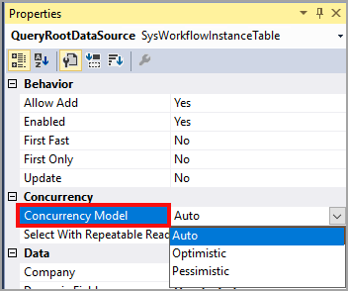
Analyze and Optimize Concurrency
Concurrency is used to control data availability for other processes in finance and operations apps, which use two models:
Pessimistic Concurrency Control (PCC).
Optimistic Concurrency Control (OCC).
PCC should be used when there is serialization logic or update conflicts, while OCC is preferred when tables are updated or deleted from a form.
OCC has advantages such as using fewer resources, locking records for a shorter time, and allowing records to remain available for other processes.
The disadvantage of OCC occurs when two processes try to update the same record at the same time.
Most tables in finance and operations apps use OCC.

Slide 146
Apply Parallel Processing Algorithms
Developers use three types of parallel processing for batch processing:
Individual task modeling
Creates a separate batch task for each work item.
Works well for a small number of work items and creates dependencies between them.
It is also simpler to develop compared to the other parallel processes.
Not ideal for many tasks because the extra overhead will affect performance and cause delays between batch tasks that are running.
Batch bundling
Uses a limited number of batch tasks that have a bundle size value (the number of work items in each batch task)
Good for a simple, even workload where processing times are similar
Performance can be increased if the bundle size is appropriate.
A bundle size that is too large or too small can experience performance issues.
Top picking
Creates a limited number of batch tasks where each batch task picks and processes the first free work item.
Ideal for an uneven workload with varying processing times and requires a staging table to store work items.
The performance of each approach depends on the bundle size and the workload characteristics.

Slide 147
Implement the Async Framework
Asynchronous processing allows finance and operations apps to run long processes in the background while users continue working.
It is useful for dealing with large amounts of data or transactions without interrupting day-to-day business processes.
To run a process asynchronously, use the runAsync methods from the FormRun and Global classes and a callback method to display a message when the process is completed.
The FormRun class’s runAsync method displays the message immediately, while the Global class's method requires the page to be refreshed.

Slide 148
Develop Windows PowerShell scripts
Windows PowerShell is a command-line shell and scripting language that can automate tasks for managing operating systems and processes.
Developers can create scripts to automate tasks and streamline processes such as database syncing, restarting services, resetting the data mart, and deploying and installing models.
PowerShell commands and providers make it easy to manage computers and access data stores.
The following are some scenarios where you can use PowerShell:
Database Sync – A PowerShell script can be used to synchronize the database.
Restart services – You can create a script to restart services.
Reset the data mart – If your organization uses Financial Reports design for financial reporting, you can write a script that resets the data mart for financial reporting.
Deploy and install models – If you want to automate deployment and installation of models, you can use a PowerShell script. You can do this for software deployable packages as well.

Slide 149
Exercise – Create Runnable Classes in Visual Studio to Test Code
Scenario: As a finance and operations apps developer, you can use runnable classes to test your code. In this lab, you will create a new project in Visual Studio, write a runnable class, then run the code within the application to ensure it is working as expected.
Task 1: Read this first – Before you start the lab!
Task 2: Scenario
Task 3: Create a new project
Task 4: Create a runnable class
Task 5: Close the lab environment
Notes:
All exercises are optional.
Link is https://learn.microsoft.com/training/modules/apply-basic-performance-optimization-finance-operations/10-exercise

Slide 150
Knowledge Check
1
You need to update the unit price of multiple sales orders. What method would be best to use?
2
You are writing a query to retrieve the customers that are not associated with a sales order. What join between the Customer table and the Sales table should you use?
3
You need to run a process in parallel. There are around 1,000 work items that would need to run with a bundle size of 100. You know that the run time for each work item will vary. What approach should you take to run this process?
Notes:
update_recordSet: The update_recordSet method updates multiple records with one call to the database and is the best method to use.
NotExists join: A notExists join would return customer data for customers who are not associated with a sales order.
Top picking: The top picking approach handles multiple records and handles uneven workloads well.

Slide 151
Summary
In this module, you learned:
Optimizing finance and operations apps is crucial for proper system performance.
Lack of optimization can lead to decreased system performance, hindering users’ ability to complete tasks in a timely manner.
To optimize the system, use proper queries, temporary tables, and investigate parallel and asynchronous processing for long processes.
Lifecycle Services and Optimization advisor workspace can be used to monitor performance.

Slide 152
Video: Extended data security
In this video, we will see how to create and implement extended data security
Time: 3 minutes
https://aka.ms/MB500Learning Path 2Video
Additional reference for security: Plan and implement security in finance and operations apps - Training | Microsoft Learn
Notes:
Video: https://aka.ms/MB500Learning Path 2Video
Additional reference: https://learn.microsoft.com/training/modules/plan-implement-security-finance-operations/

Slide 153
Lab 2: Create a new EDT table and form
We’ll create a new table and supporting form
Time: 30 minutes
Exercise 1: Create model and project
Exercise 2: Create new data types
Exercise 3: Create new data models
Exercise 4: Create new user interfaces

Slide 154
Learning Path Recap
LP1
Learning Path 2
In this learning path, we:
Learned how to set up a VHD
Familiarized ourselves with using Visual Studio for developing
Got started with development using X++
Learned about developing object-oriented code
Discussed application lifecycle management
Built and optimized extended data types and enums, data model elements, forms, classes, reports, and workspaces
Discussed role-based security

Slide 155
Closing slide

